Slide 1
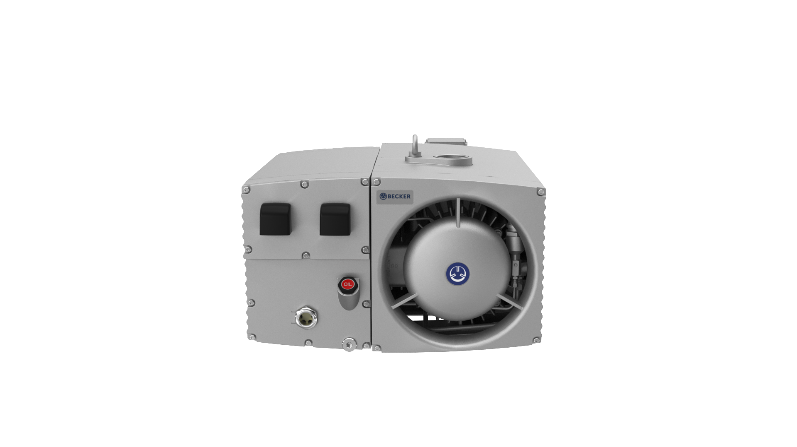
Becker
U5.
Oil lubricated rotary vane pumps

Slide 2
German made
oil lubricated rotary vane pumps
Five frame sizes 70-360 m3/h
Fastest pump-down times
Fastest reaching of ultimate pressure
Even after cold starting
Low power consumption
Hygienic Design
Smooth surfaces for quick. easy and hygienic cleaning
Compact dimensions
O2-PACK
Version for oxygen – same length as standard version
VARIAIR
Intelligent frequency inverter with additional features

Slide 3
U5.
for a variety of applications
Food packaging
Food processing
Tumblr
Dry freezing
Vacuum mixer/ Sausage machinery
Degassing of materials (electronics, food …)
Medical central systems
Thermoforming
Rubber molding
Drying of materials or parts
CNC router tables
(Reflow) Soldering
Lamination of materials
And many more

Slide 4
U5.
Design / Concept

Slide 5
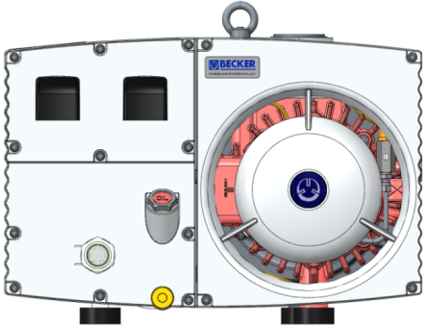
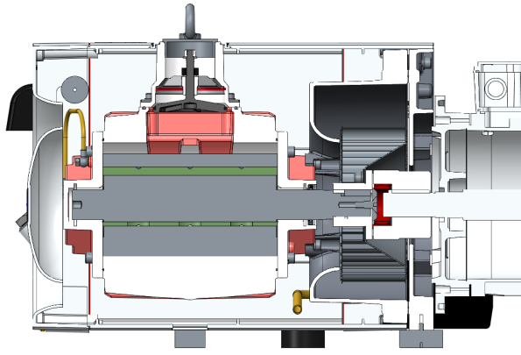
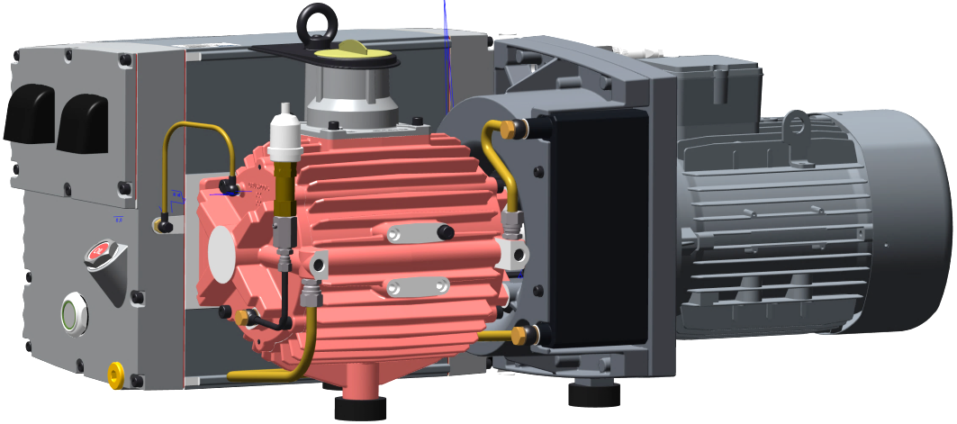
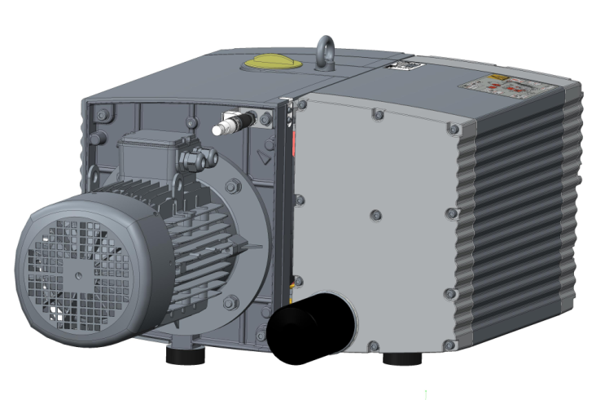
U5.
design / concept

Slide 6
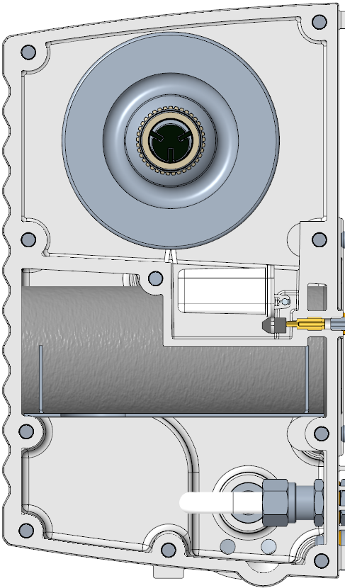
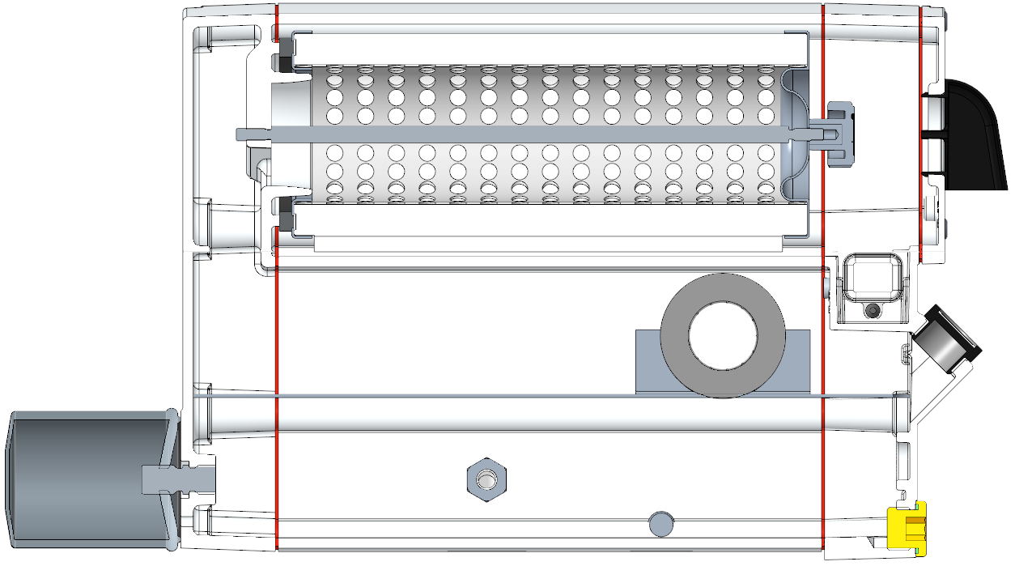
U5.77/101
design / concept
Air guidance and oil return are integrated into the side covers/ lids

Slide 7
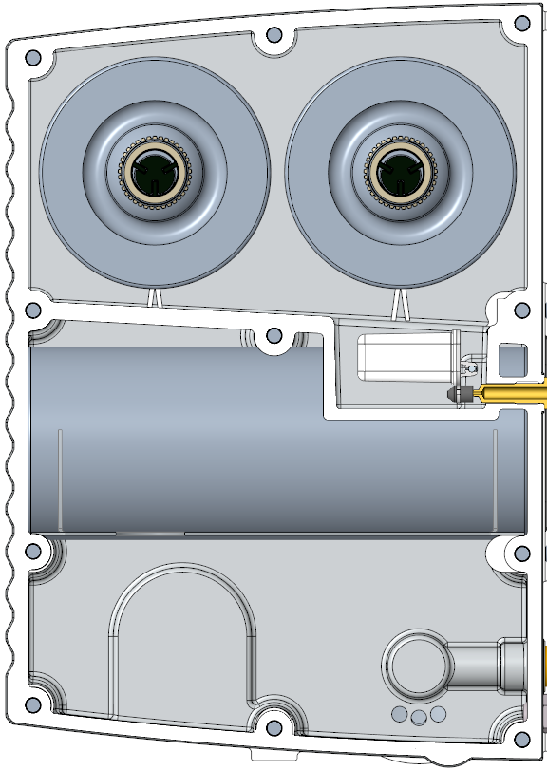
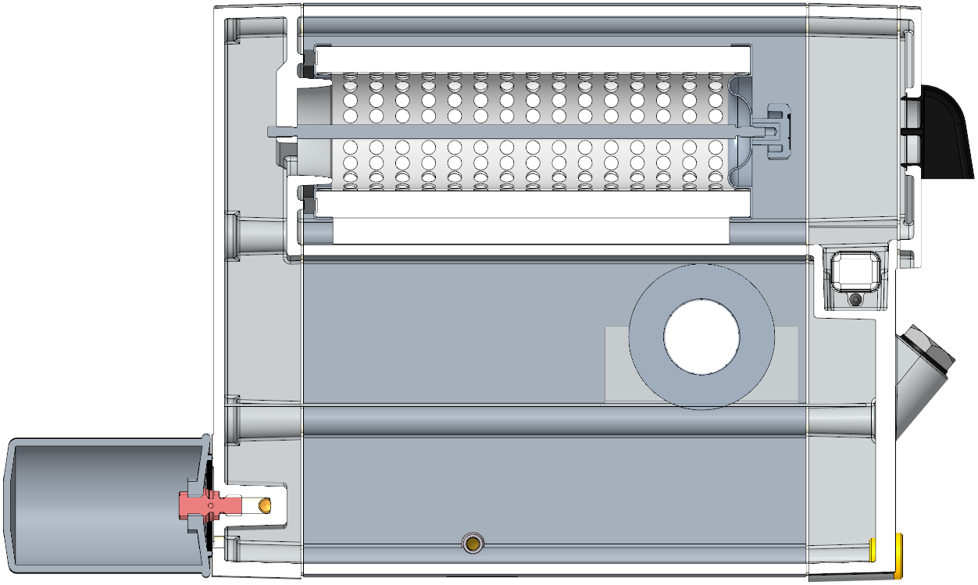
U5.166/201/301
design / concept
Air guidance and oil return are integrated into the side covers / lids

Slide 8
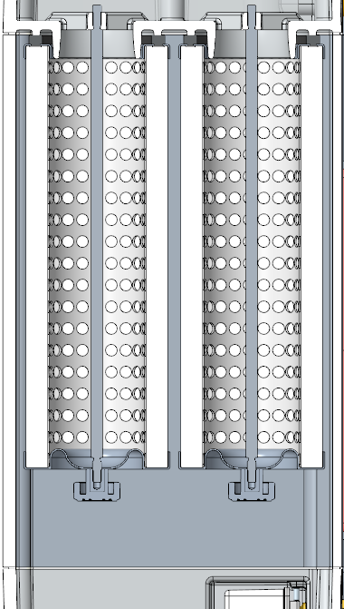
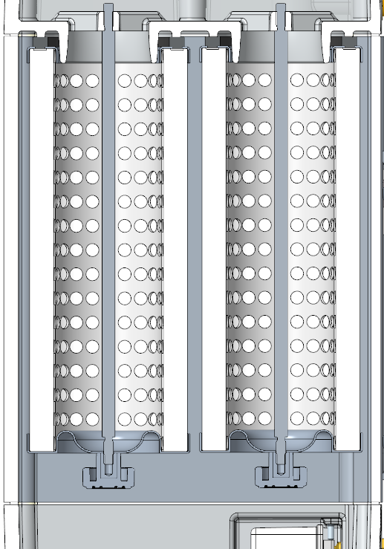
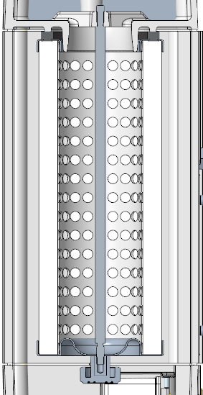
U5.
design / concept
71-201 share the same elements
301
166/201
71/101

Slide 9
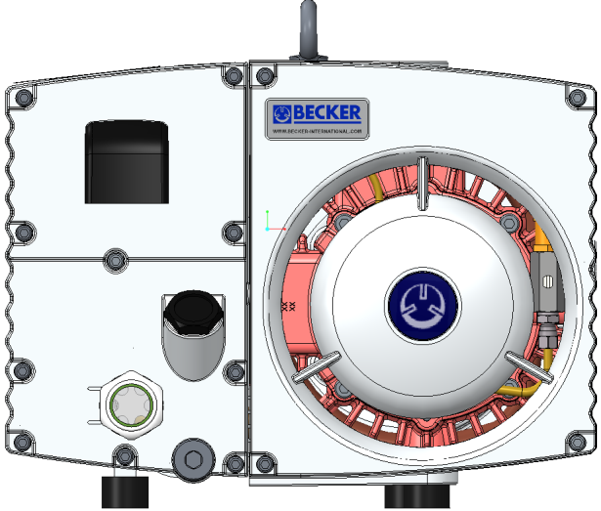
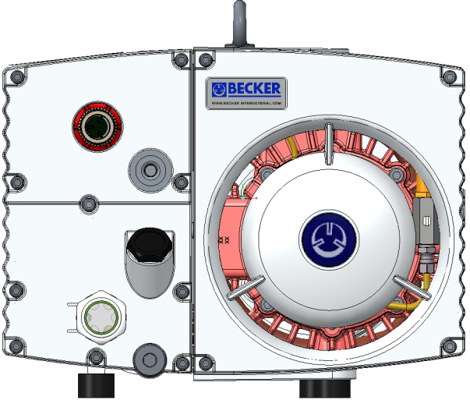
U5.71/101
exhaust connection
Standard (Diverting cap)
Optional (Female thread
and burst valve)

Slide 10
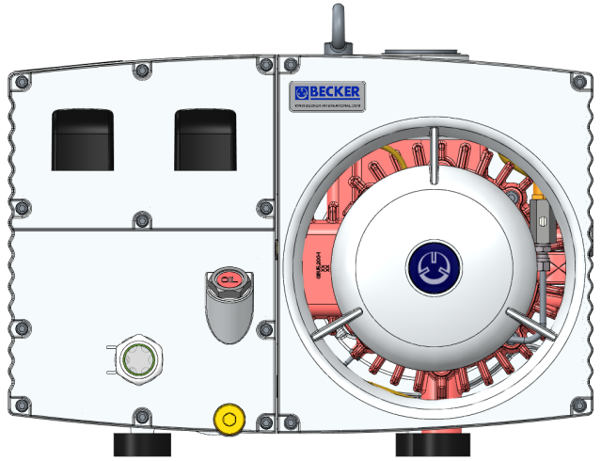
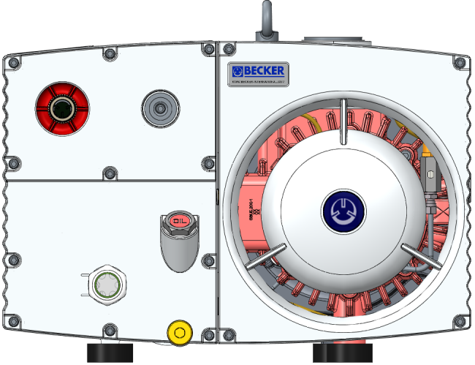
U5.71/101
exhaust connection
Standard (Diverting cap)
Optional (Female thread
and burst valve)

Slide 11
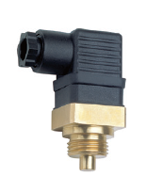
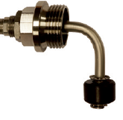
accessories
U5.
U5.166/201/301 with standard covers
U5.166/201/301 Optional covers Female thread with burst valve
Plug or maintenance indicator for oil separating elements
Exhaust
air
Oil inlet
Oil level switch (or plug)
Oil drain screw; oil outlet
Oil sight glass for oil check (min/max)
Oil temperature monitor
Optional: Service cover with different options

Slide 12
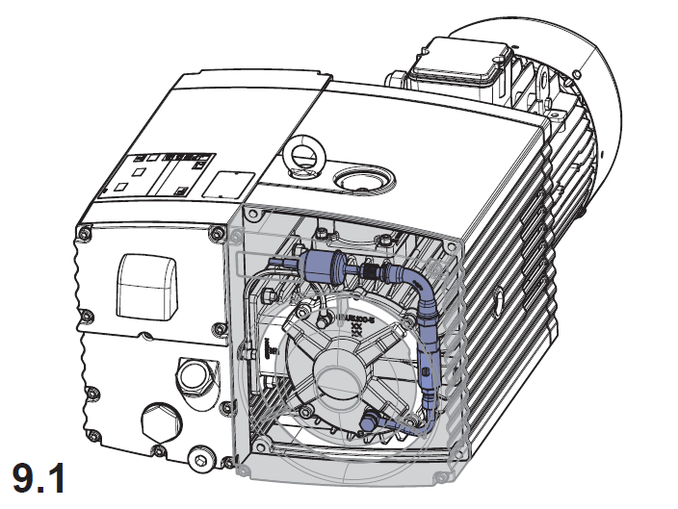
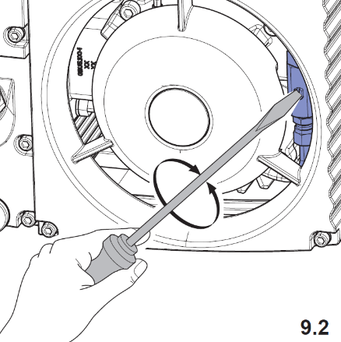
gas ballast valve
U5.
U5.71 & U5.102
Fixed gas ballast valve <1 mbar as standard
Adjustable optional gas ballast valve <3 mbar for moist applications
U5.166-301
Adjustable gas ballast valve <1 mbar as standard
Adjustable optional gas ballast valve <3 mbar for moist applications
Ultimate vacuum without gas ballast valve <0.1 mbar

Slide 13
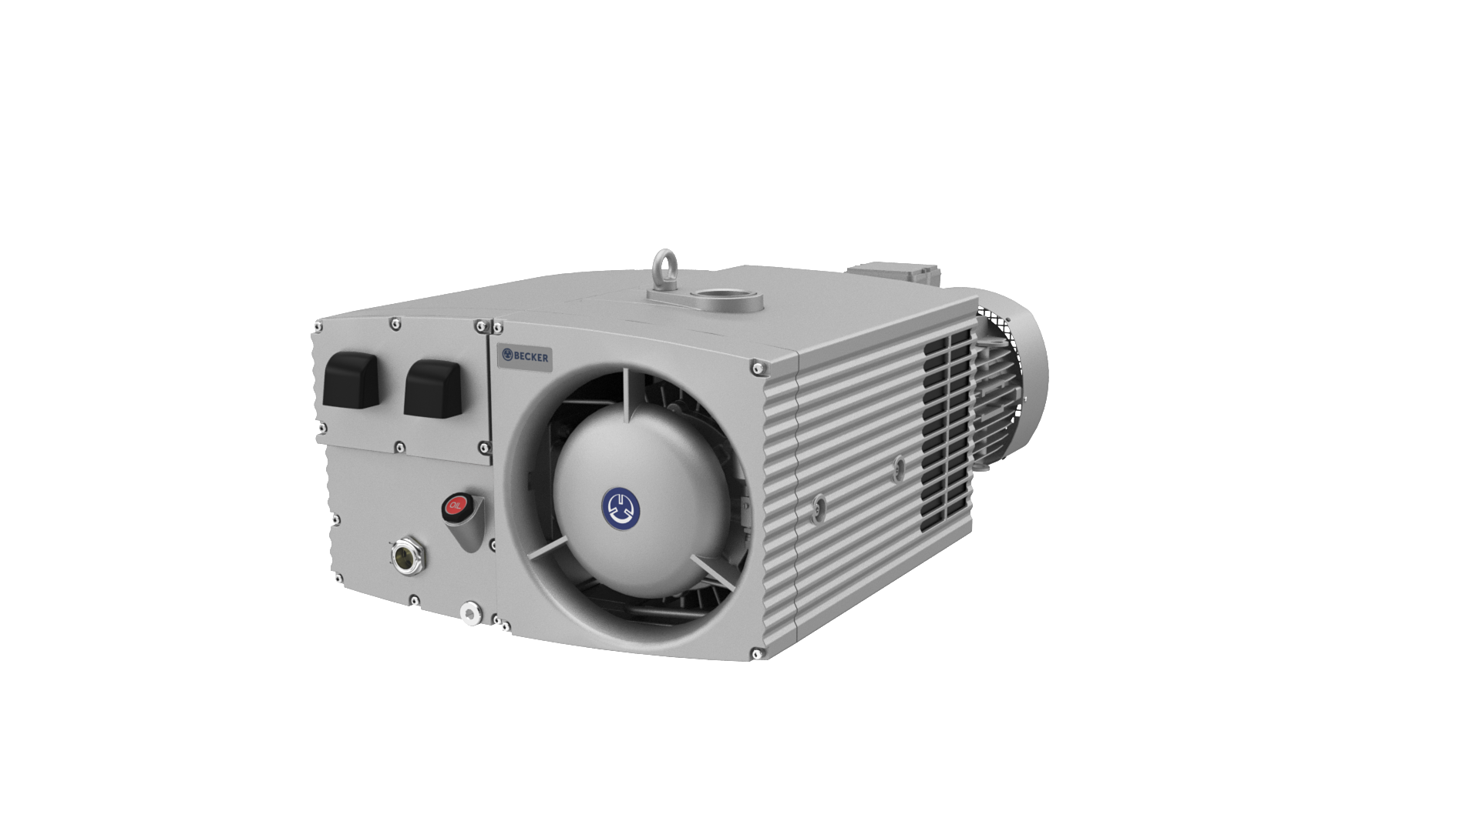
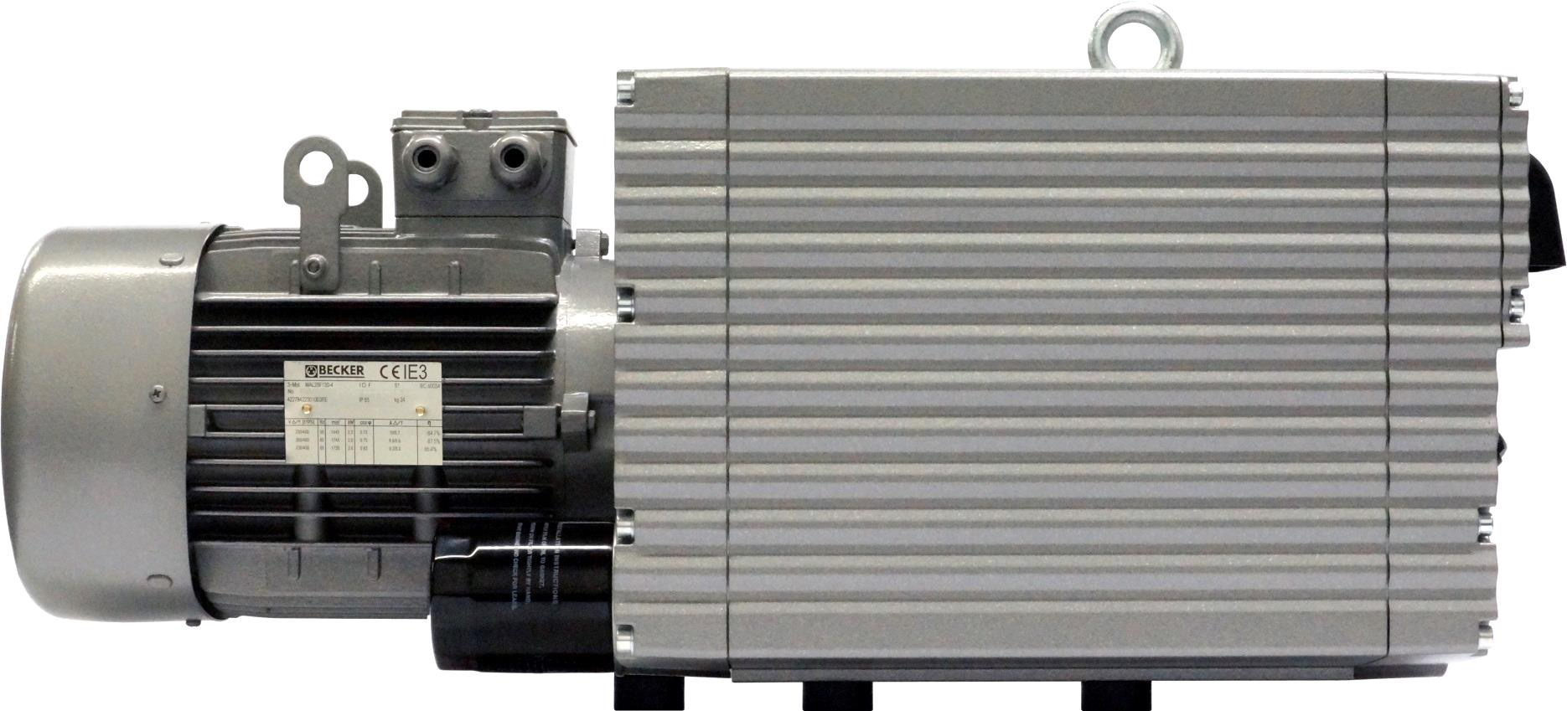
external
U5.
Smooth surfaces
Reduction of deposits in potential nests
Corrosion resistance
All U5. pumps are lacquered
Wash-down capable
IP55

Slide 14
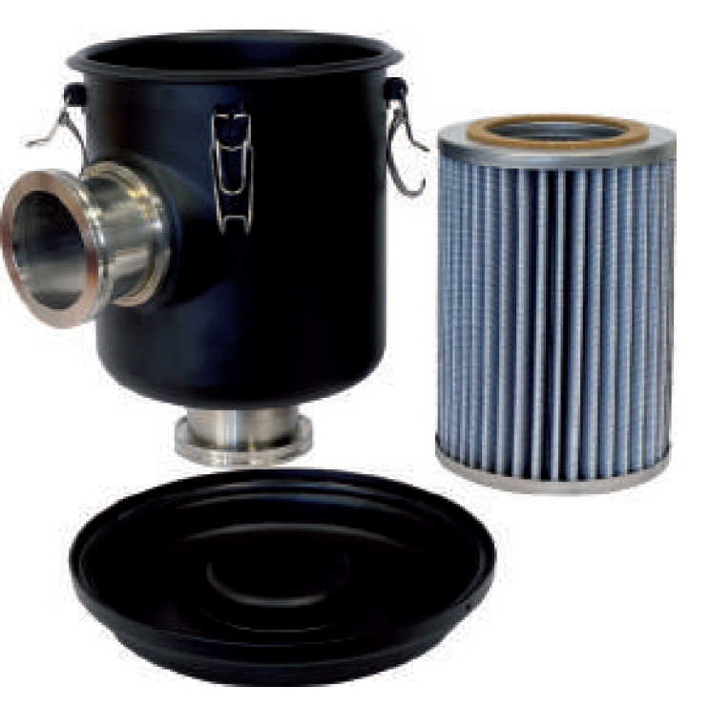
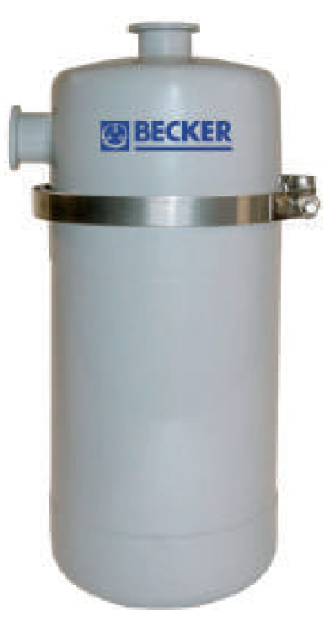
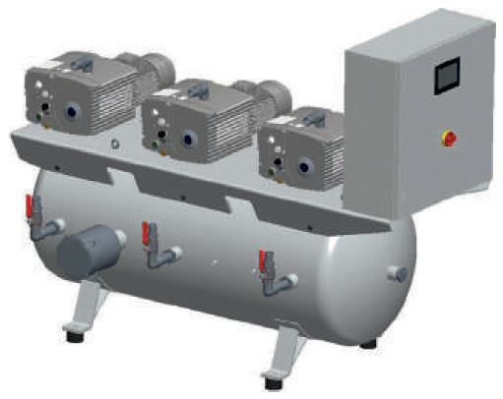
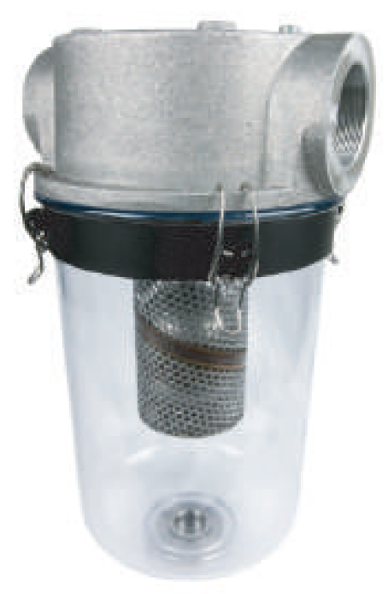
U5.
accessories and systems
Broad range of external accessories
Inlet filters
Water separators
Tank systems
Cables
Etc.

Slide 15
U5.
XL version
U5.71 – 301 XL versions for rough vacuum applications
Key benefits
Better oil separation
Longer oil tank (twice the length) => better separation because of gravity
Additional separating element => better oil recovery
Heavy air flow protection for the float chamber => less risk of oil carry-over
Longer service intervals
Additional separating element => better oil recovery
Increased surface => better cooling capabilities

Slide 16
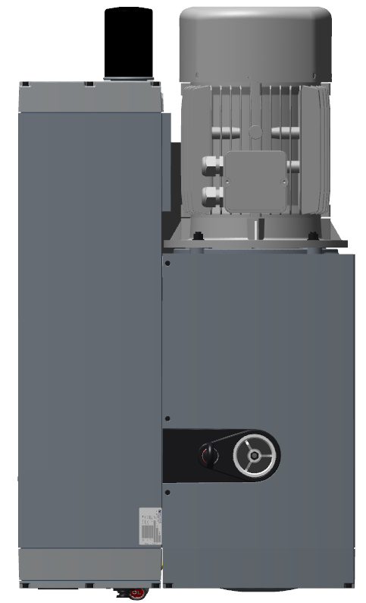
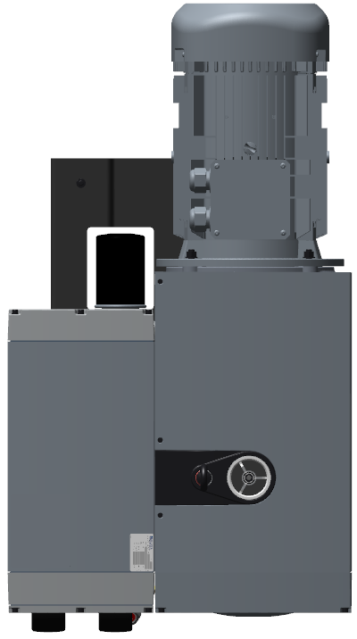
U5.300
XL

Slide 17
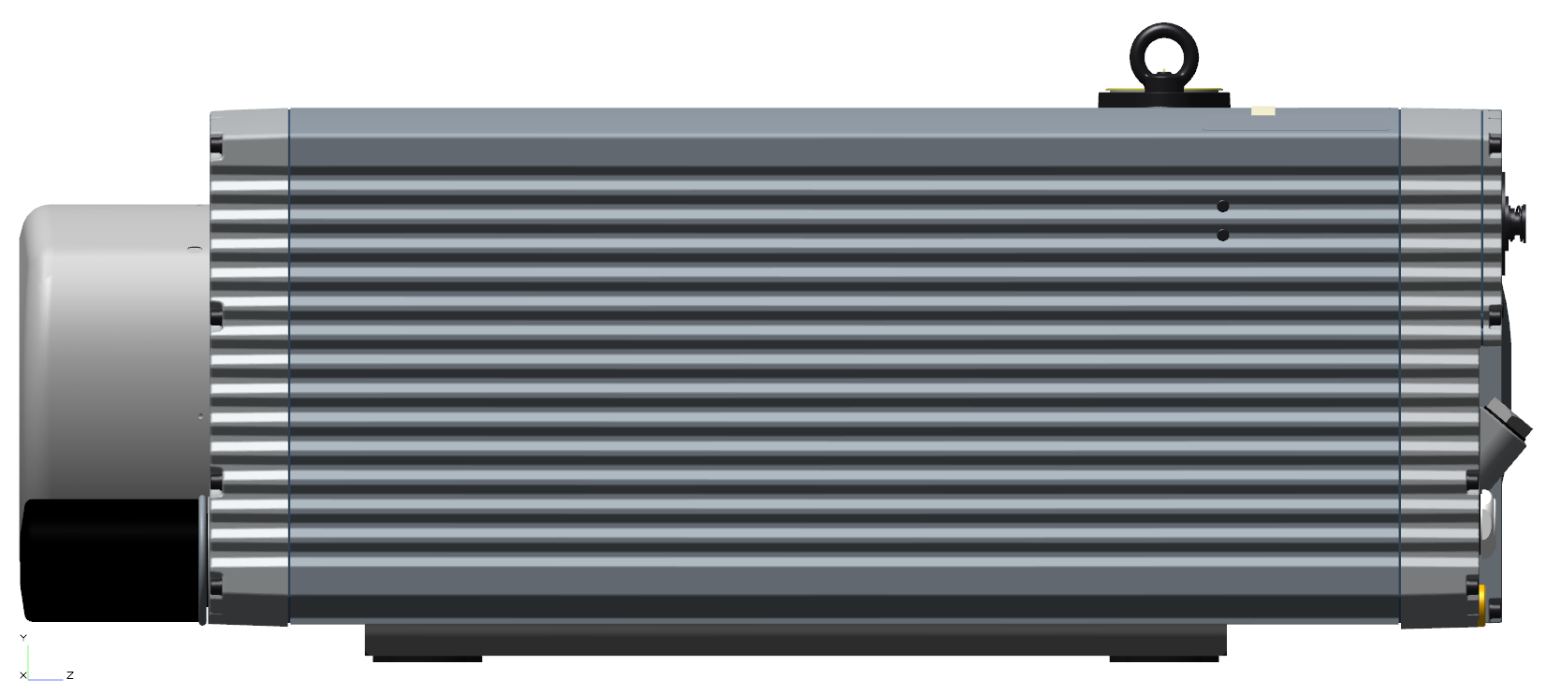
U5.
XL

Slide 18
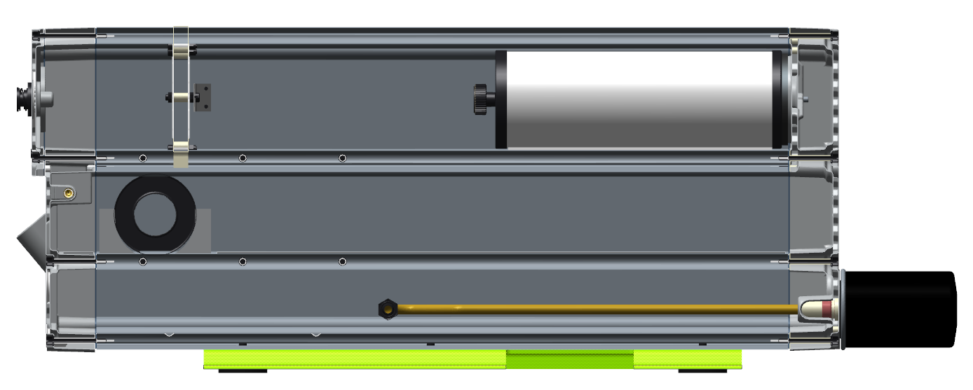
U5.
XL oil separation
Standard U5.300

Slide 19
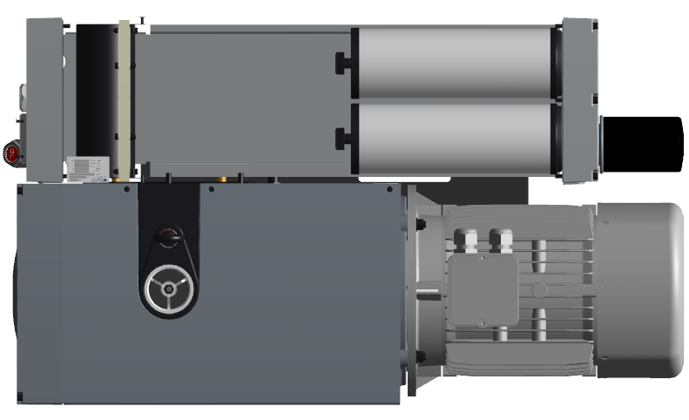
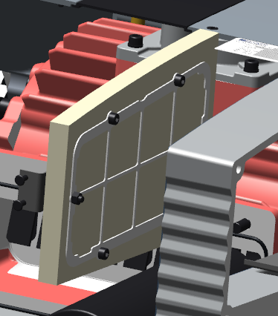
U5.
XL additional oil separation stage

Slide 20
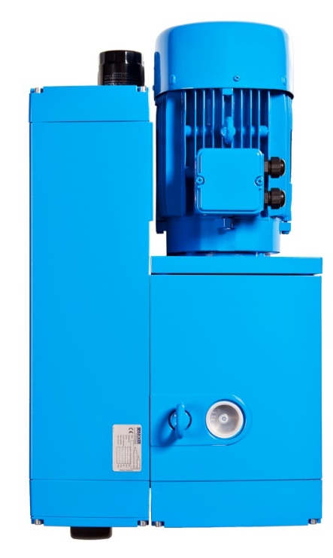
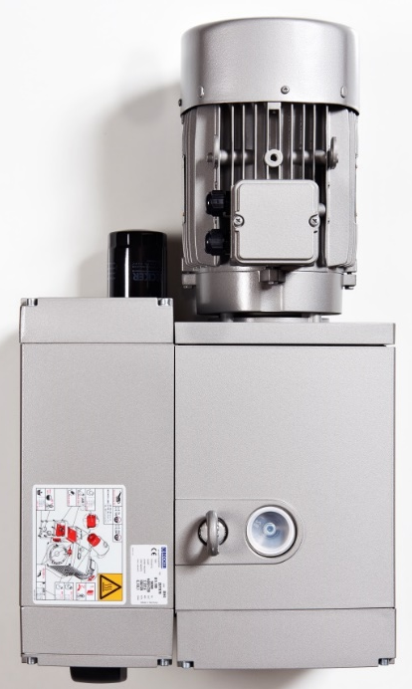
U5.
O₂-PACK
Suitable for oxygen
Fomblin-oil
BAM conform materials
Same length as standard U5.
Even though there is an additional internal oil separator
No external oil separator
3-time separation
Coarse separator
Oil separator element
Additional separator
Versions
U5.71-301

Slide 21
vs. R5 RA 63F
Becker U5.71
Construction size | U5.71 | R 5 RA 63 F
Length [mm] | 696 (IE3) | 627 (IE2)
Width [mm] | 380 | 406
Height [mm] | 289 | 290
Mass [kg] | 67 | 55
Nominal pumping speed [m³/h 50/60 Hz] | 70/84 | 63/76
Motor power [kW – 50/60 Hz] | 1.5/1.8 | 1.5/1.8 2.2/2.7
Noise level [dB(A)] | 64/67 | 64/67

Slide 22
vs. R5 RA 100F
Becker U5.101
Construction size | U5.101 | R 5 RA 100 F
Length [mm] | 736 (IE 3) | 701 (IE 2)
Width [mm] | 380 | 406
Height [mm] | 289 | 290
Mass [kg] | 67 | 73
Nominal pumping speed [m³/h 50/60 Hz] | 100/120 | 100/120
Motor power [kW – 50/60 Hz] | 2.2/2.6 | 2.2/2.7 2.7/3.4
Noise level [dB(A)] | 65/68 | 65/68

Slide 23
vs. R5 RA 160 D
Becker U5.166
Construction size | U5.166 | R 5 RA 160 D
Length [mm] | 810 | 920
Width [mm] | 510 | 536
Height [mm] | 360 | 410
Mass [kg] | 99 | 140
Nominal pumping speed [m³/h 50/60 Hz] | 165/198 | 160/190
Motor power [kW – 50/60 Hz] | 3.0/3.6 | 4.0/5. 5
Noise level [dB(A)] | 70/72 | 70/72

Slide 24
vs. R5 RA 202 D
Becker U5.201
Construction size | U5.201 | R 5 RA 202 D
Length [mm] | 789 | 920
Width [mm] | 510 | 536
Height [mm] | 360 | 410
Mass [kg] | 102 | 140
Nominal pumping speed [m³/h 50/60 Hz] | 200/240 | 200/240
Motor power [kW – 50/60 Hz] | 4.0/4.8 | 4.0/6.6
Noise level [dB(A)] | 72/74 | 72/74

Slide 25
vs. R5 RA 302 D vs. R5 RD 360
Becker U5.301
Construction size | U5.301 | R 5 RA 302 | R5 RD 360
Length [mm] | 946 | 1011 | 990
Width [mm] | 549 | 581 | 530
Height [mm] | 365 | 410 | 410
Mass [kg] | 143 | 190 | 190
Nominal pumping speed [m³/h 50/60 Hz] | 300/360 | 300/360 | 300/360
Motor power [kW – 50/60 Hz] | 5.5/6.6 7.5/9.0 | 5.5/6.6 7.5/9.0 | 5.5/6.6 7.5/9.0
Noise level [dB(A)] | 73/76 | 74/76 | 70/72

Slide 26
vs. U4.300 vs. U4.250
Becker U5.301
Construction size | U5.301 | U4.300 | U4.250
Length [mm] | 946 | 1075 | 1097
Width [mm] | 549 | 533 | 531
Height [mm] | 365 | 418.5 | 385
Mass [kg] | >143 | >145 | >145
Nominal pumping speed [m³/h 50/60 Hz] | 300/360 | 300/360 | 244/276
Motor power [kW – 50/60 Hz] | 5.5/6.6 7.5/9.0 | 5.5/6.6 7.5/9.0 | 5.5/6.6 7.5/9.0
Noise level [dB(A)] | 73/76 | 74/76 | 73/76

Slide 27
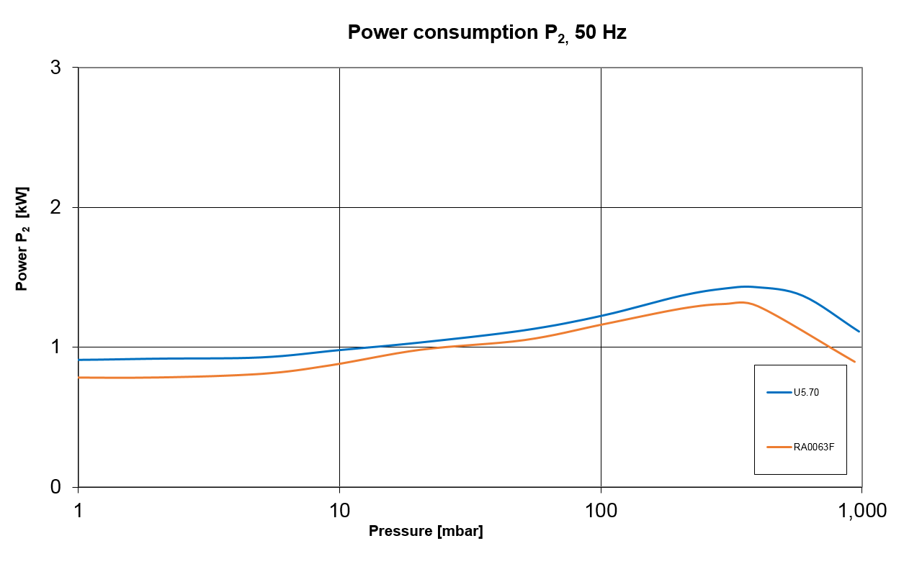
vs. R5 RA 0063 F
Becker U5.71

Slide 28
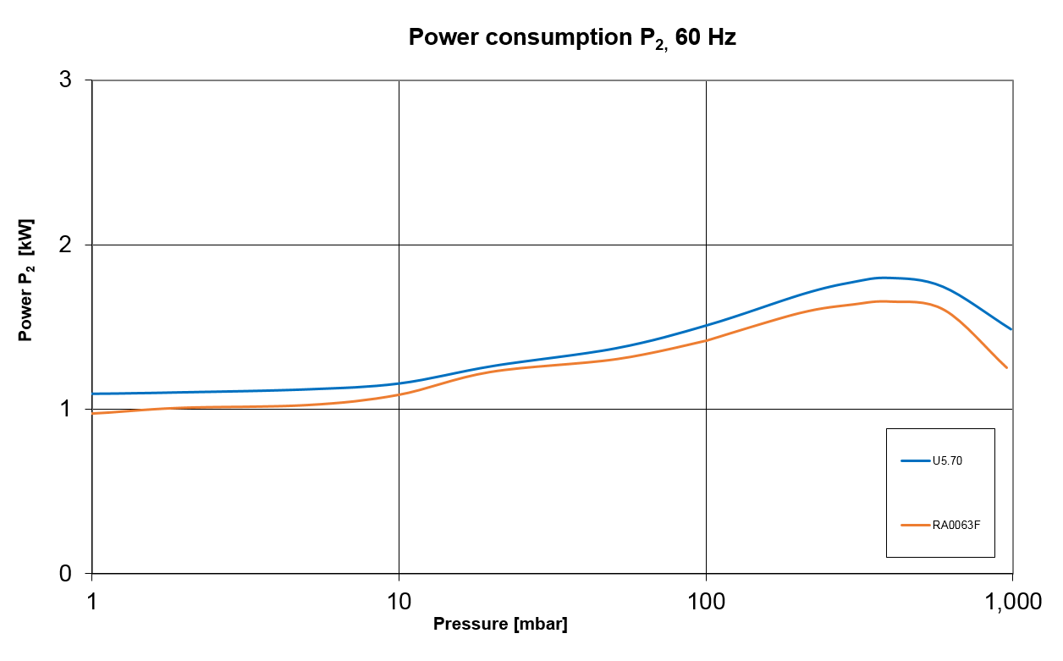
vs. R5 RA 0063 F
Becker U5.71

Slide 29
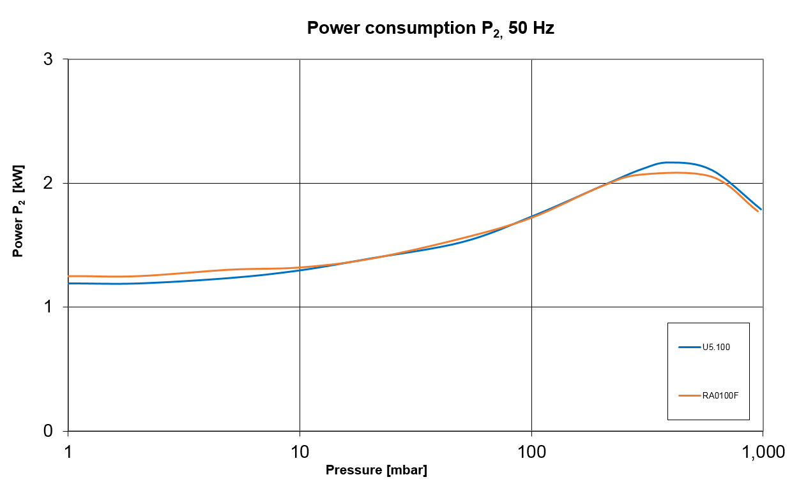
vs. R5 RA 0100 F
Becker U5.101

Slide 30
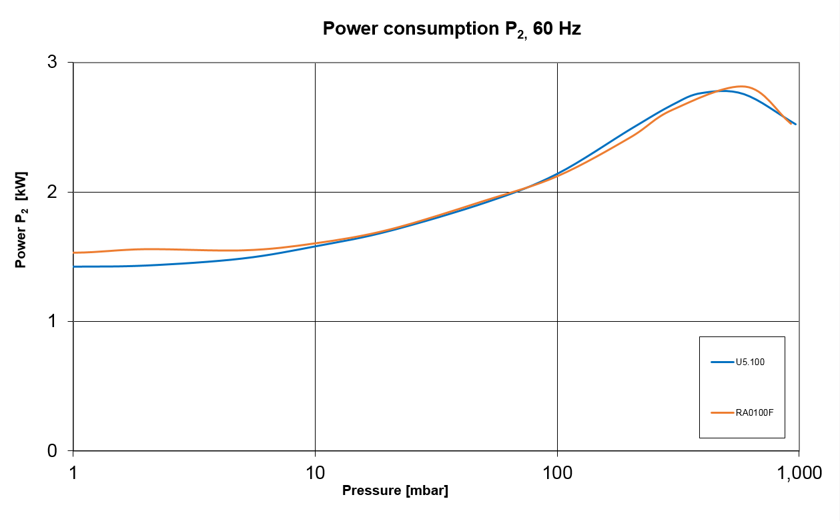
vs. R5 RA 0100 F
Becker U5.101

Slide 31
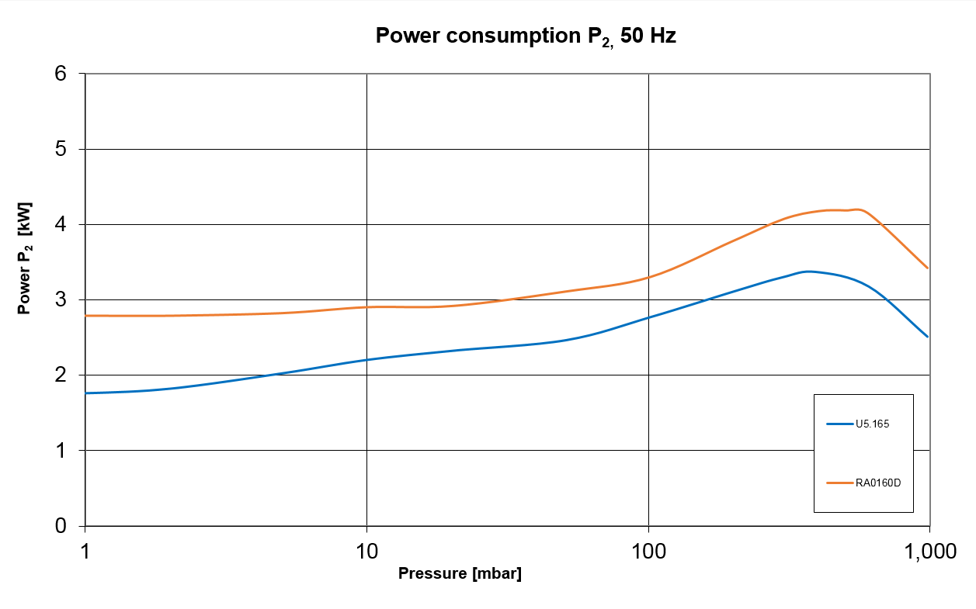
vs. R5 RA 0160 D
Becker U5.166

Slide 32
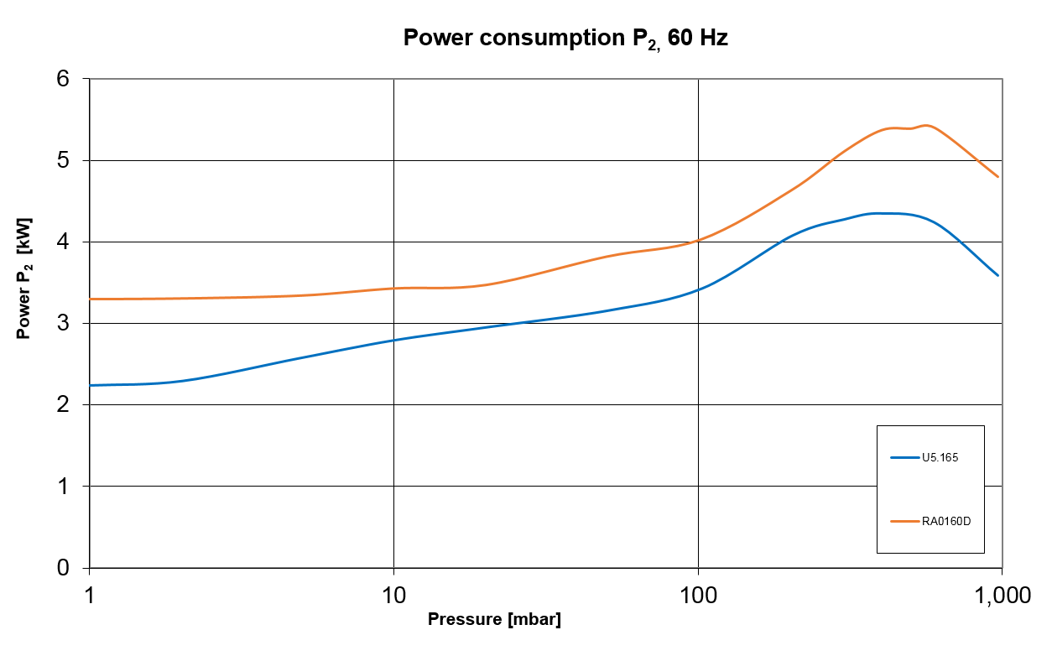
vs. R5 RA 0160 D
Becker U5.166

Slide 33
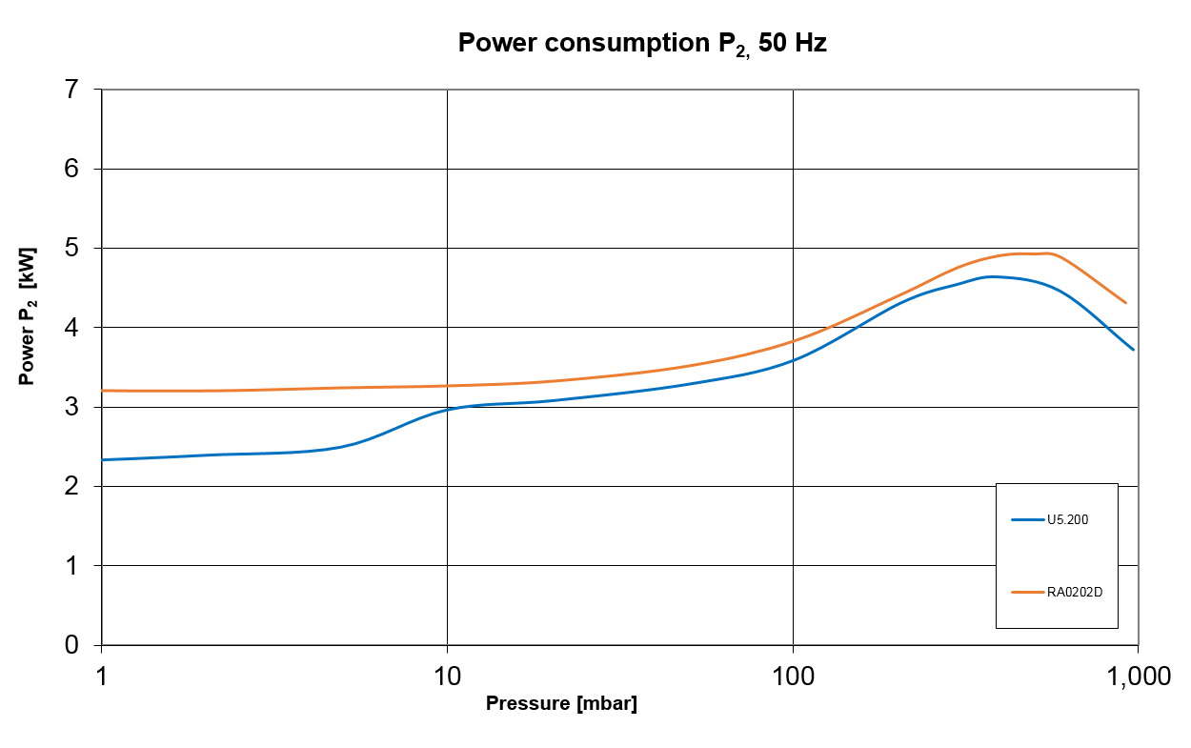
vs. R5 RA 0202 D
Becker U5.201

Slide 34
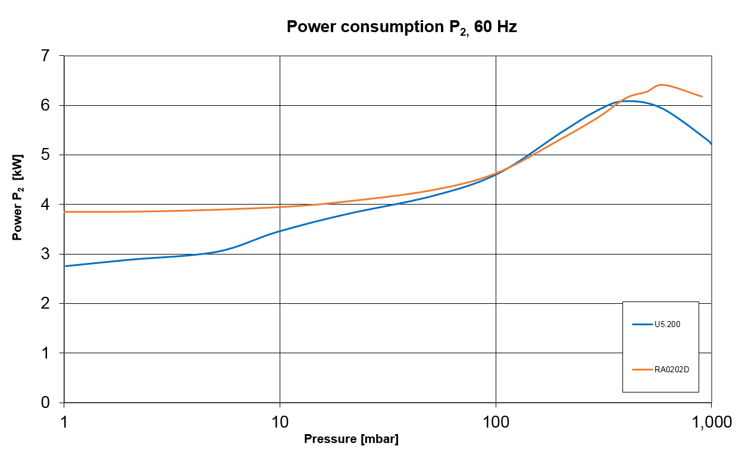
vs. R5 RA 0202 D
Becker U5.201

Slide 35
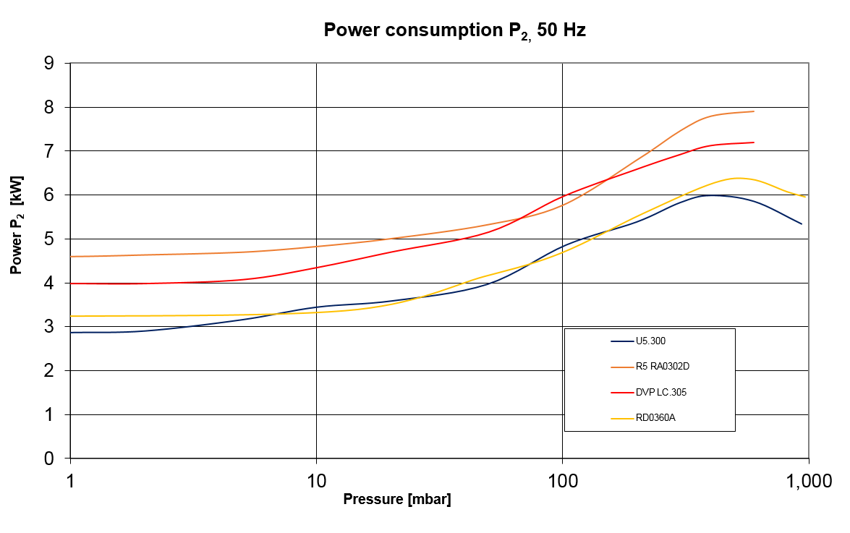
vs. R5 RA 0302 D
Becker U5.301

Slide 36
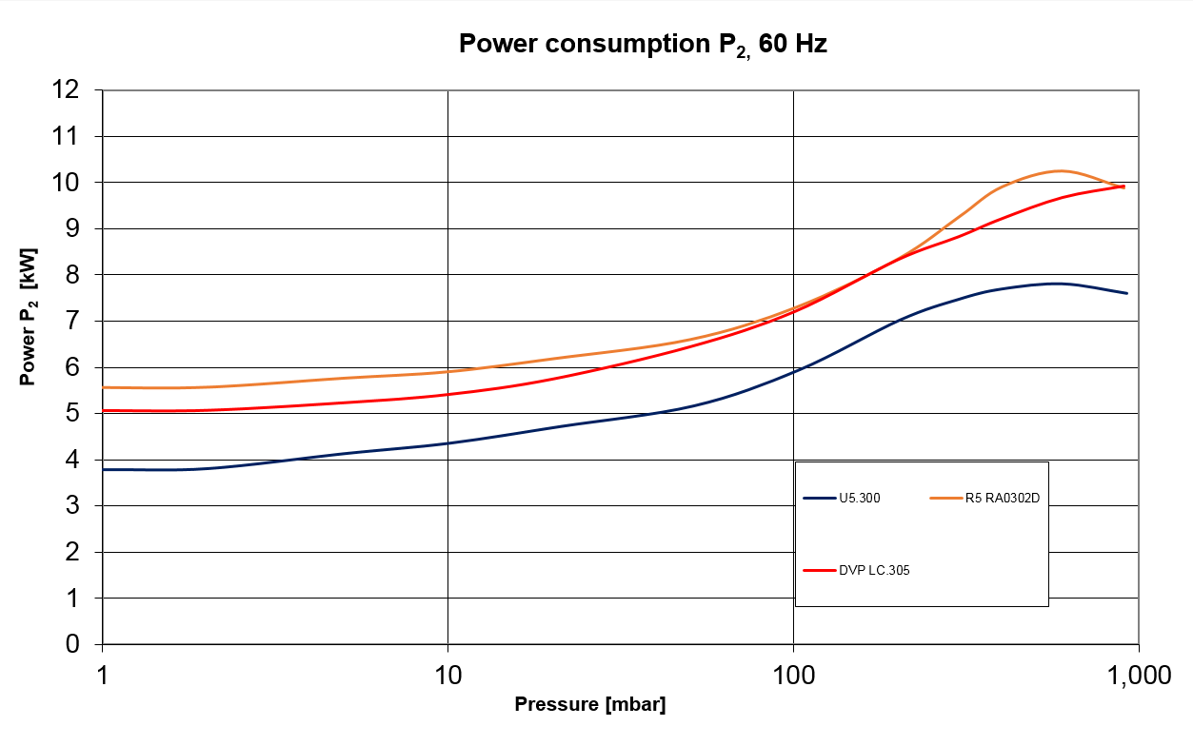
vs. R5 RA 0302 F
Becker U5.301

Slide 37
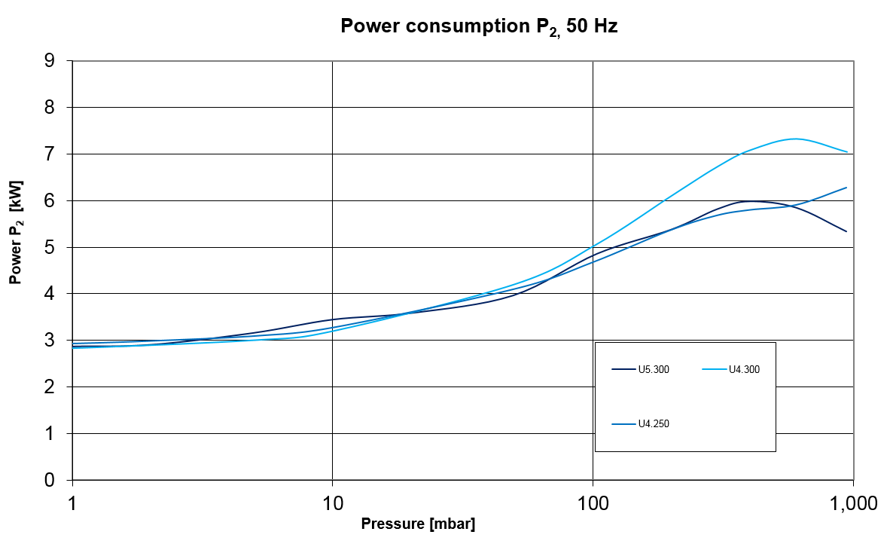
vs. U4
Becker U5.301

Slide 38
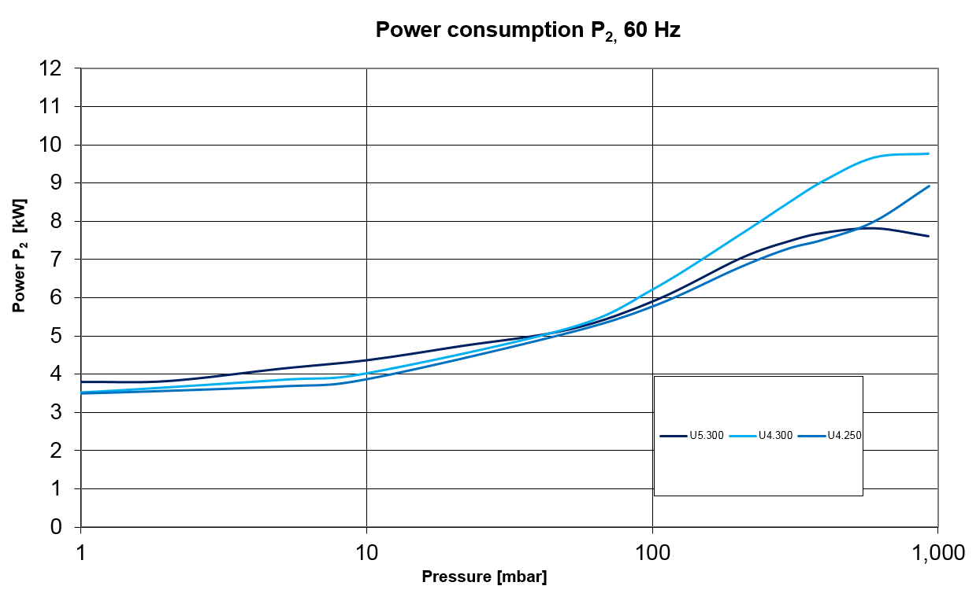
vs. U4
Becker U5.301

Slide 39
U5.
motor power
Volume | Becker U5. (50/60Hz) | Busch R A R5 (50/60Hz)
70m³/h | 1.5/1.8 | 1.5/1.8 2.0/2.7
100m³/h | 2.2/2.6 | 2.2/2.6 2.7/3.4
165m³/h | 3.0/3.6 (4.0/4.8) | 4.0/5.5
200m³/h | 4.0/4.8 (5.5/6.6) | 4.0/5.5
300m³/h (U4.) | 5.5/6.6 (7.5/9.0) | 5.5/7.5
400m³/h (U4.) | 11.0/13.2 | 11.0/15.0
630m³/h (U4.) | 15.0/18.0 | 15.0/18.5

Slide 40
U5.
standard motor voltages (IE3) <5.5kw
1. 3~ (Europe) 50Hz Δ-/ Y400V ± 10% (IE3) 60Hz Δ265/ Y460V ± 10% (IE3) 60Hz Δ230/ Y400V ± 10% | 2. 3~ (USA) 60Hz YY230/ Y460V ± 10% (IE3+UL/CSA) 60Hz usable @ 208V ± 10%
3. 3~ (JP/KR/BR) 50Hz Δ200/ Y350V ± 10% 60Hz Δ220/ Y380-400V ± 10% (IE3) 60Hz Δ200/ Y350V ± 10% | 4. 3~ 60Hz Δ400/ Y690V ± 10% (IE3)

Slide 41
U5.
standard motor voltages (IE3) >5.5kw
1. 3~ (Europe) 50Hz Δ400 V/ Y- ± 10% (IE3) 60Hz Δ265 V/ Y- ± 10% (IE3) 60Hz Δ230 V/ Y- ± 10% | 2. 3~ (USA) 60Hz YY230/ Y460V ± 10% (IE3+UL/CSA) 60Hz usable @ 208V ± 10%
3. 3~ (JP/KR/BR) 50Hz Δ200/ Y350V ± 10% 60Hz Δ220/ Y380-400V ± 10% (IE3) 60Hz Δ200/ Y350V ± 10% | 4. 3~ 60Hz Δ400/ Y690V ± 10% (IE3)

Slide 42
Thank you for your attention!

