Slide 1
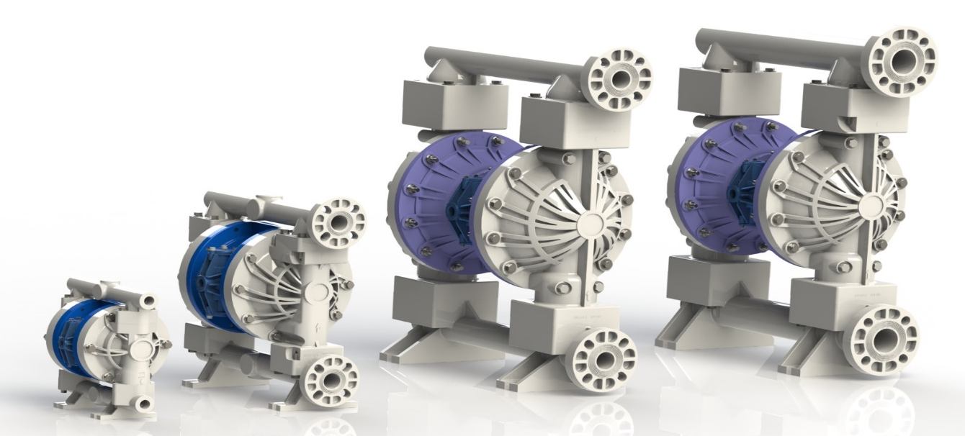

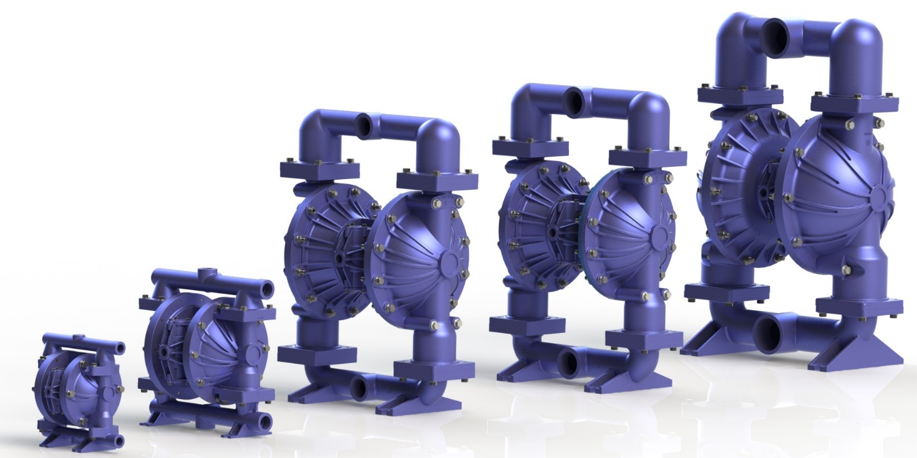
2016 Launch

Slide 2
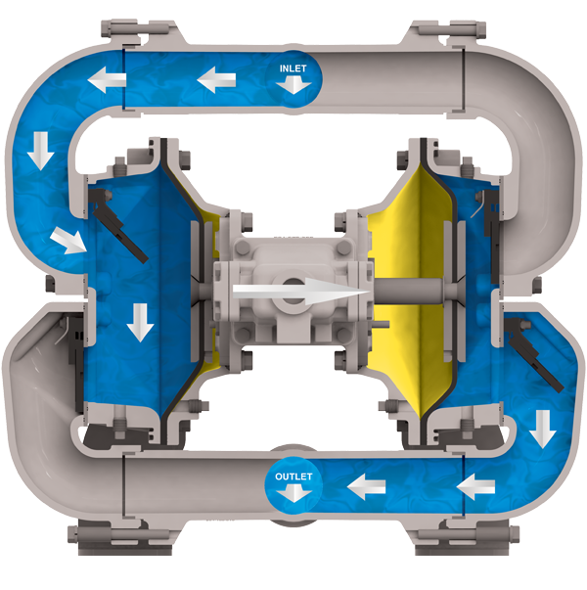
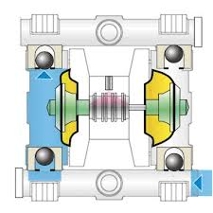

What is an AODD ?
A diaphragm pump (also known as a membrane pump, air-operated double diaphragm pump [AODD] or pneumatic diaphragm pump) is a positive displacement pump that uses a combination of the reciprocating action of a rubber, thermoplastic or Teflon® diaphragm and suitable valves either side of the diaphragm (flap valves, or ball valve) to transfer a fluid.

Slide 3
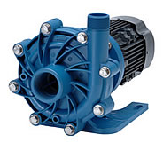
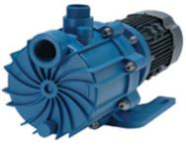
FTI and FTI-Air (AODD)
FTI Mag-Drive Centrifugal
FTI-Air
run-dry-capability
seal-less pump
self-priming
simple to maintain
simple assembly
leak-free
run-dry-capability
no mechanical seals
self-priming
simple to maintain
simple assembly
leak-free

Slide 4
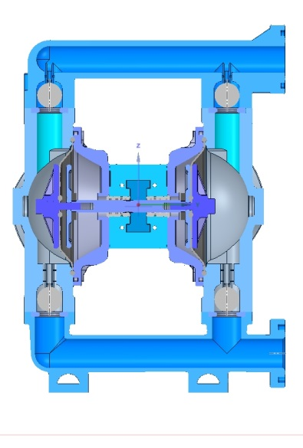
Diaphragm pump components & locations
Air chamber
Air distribution system
Outer diaphragm plate
Inner diaphragm plate
Valve ball
Valve seat
Discharge manifold
Liquid chamber
Diaphragm
Suction manifold
7
1
2
8
3
4
9
5
6
10

Slide 5
Diaphragm pump components & locations
same suction & discharge port
side ports
top to bottom ports
center ports
Example: 2” suction &
2” discharge

Slide 6
Diaphragm pump components & locations
same suction & discharge port
side ports
top to bottom ports
center ports

Slide 7
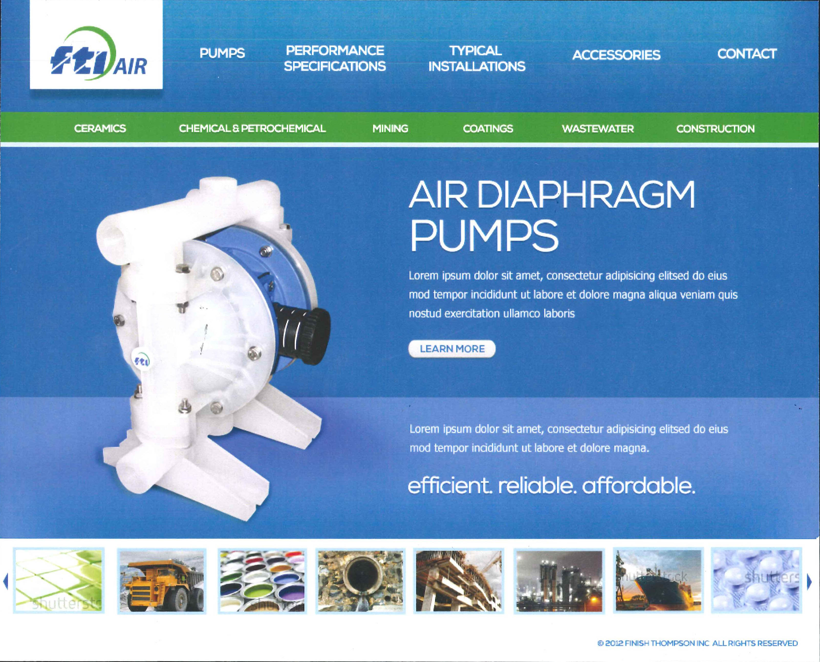
Diaphragm pump components & locations
same suction & discharge port
side ports
top to bottom ports
center ports

Slide 8
Diaphragm pump components & locations
same suction & discharge port
side ports
top to bottom ports
center ports

Slide 9
Principle of Operation

Slide 10
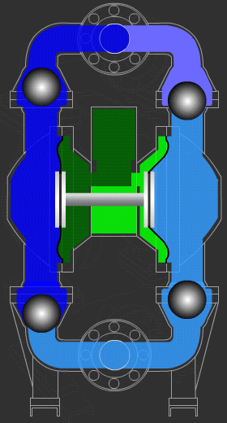
Principle of Operation
Discharge Stroke
out going fluid
incoming fluid
compressed air
vented air
2
3
MAX PRESSURE IS 7 BARS
MINIMUM PUMP FLUID
PERFORMANCE IS 10% FROM MAX
TO AVOID STALLING
1

Slide 11
Principle of Operation
Suction Stroke
out going fluid
incoming fluid
compressed air
vented air
4

Slide 12
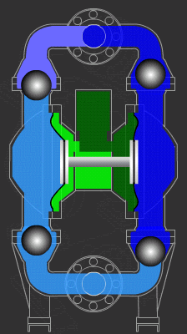
The Shifting moment !
Principle of Operation
Filling right
Emptying left
Filling left
Emptying right

Slide 13
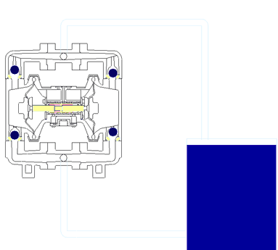
FTI pump - how it works

Slide 14
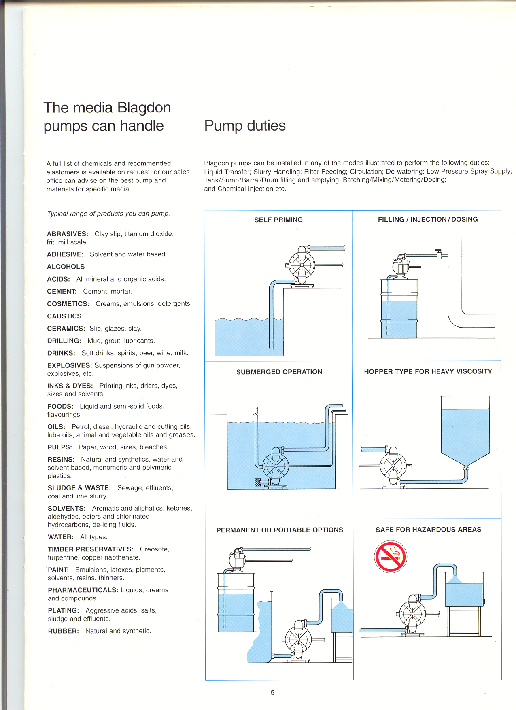
Typical Installations
ATEX Approved

Slide 15
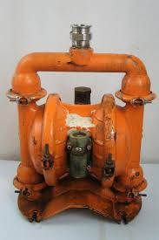

Why Choose a FTI Pump?
bolted vs. clamp design

Slide 16































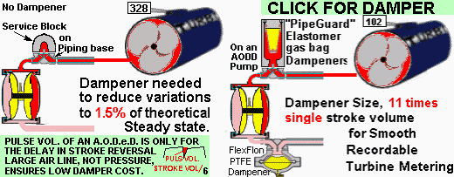

Pulsation Dampener
With Pulsation Dampener

Slide 17


THANK YOU FOR YOUR KIND ATTENTION!

