Slide 1
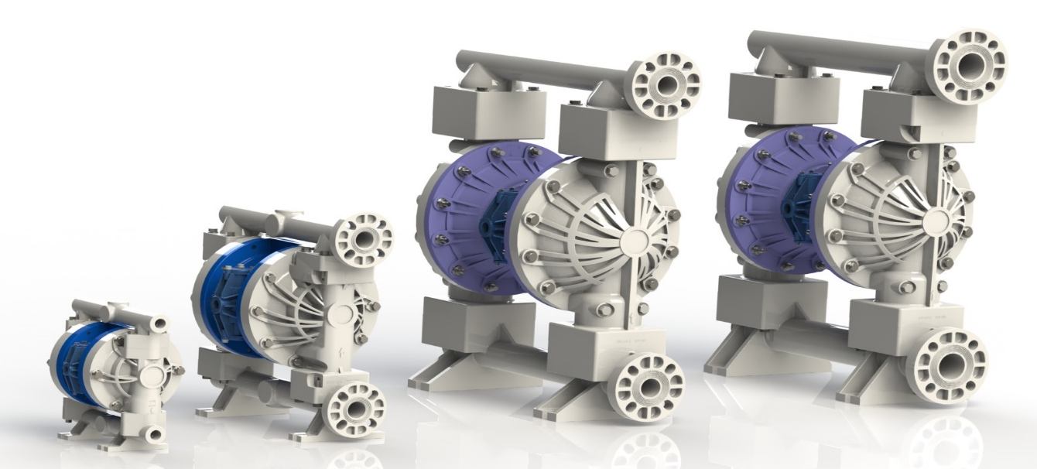
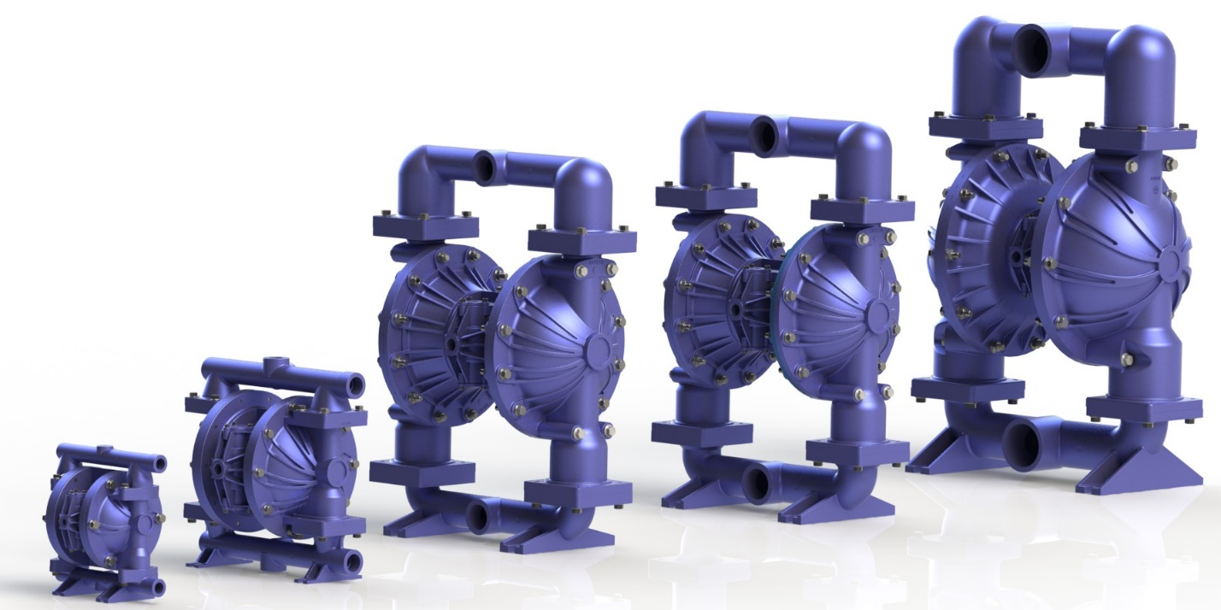
2016 Launch

Slide 2
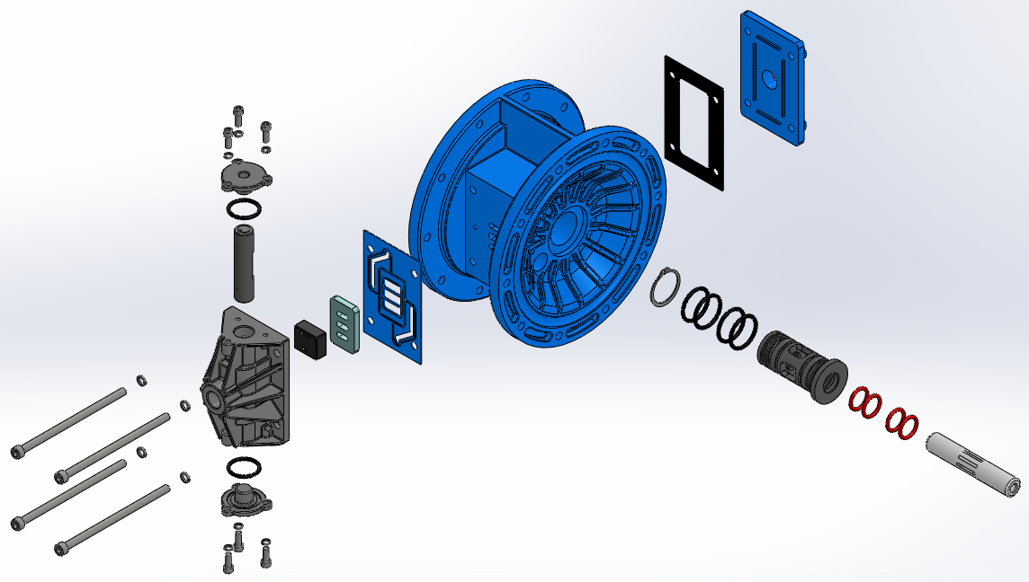
FTI AIR- ADS VS COMPETITORS
Valve Carrier
Aluminum End Cap
Bushing
Slide Valve Shoe
Valve Plate

Slide 3
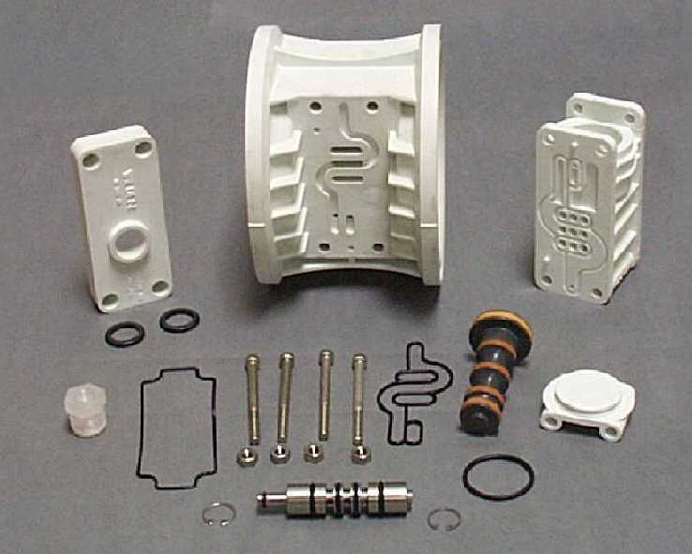
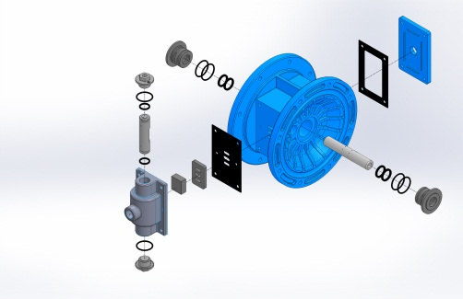
Wilden 1” Pro-Flo ADS
Wilden Pro-Flo 1-inch Air Distribution System
28 Parts

Slide 4
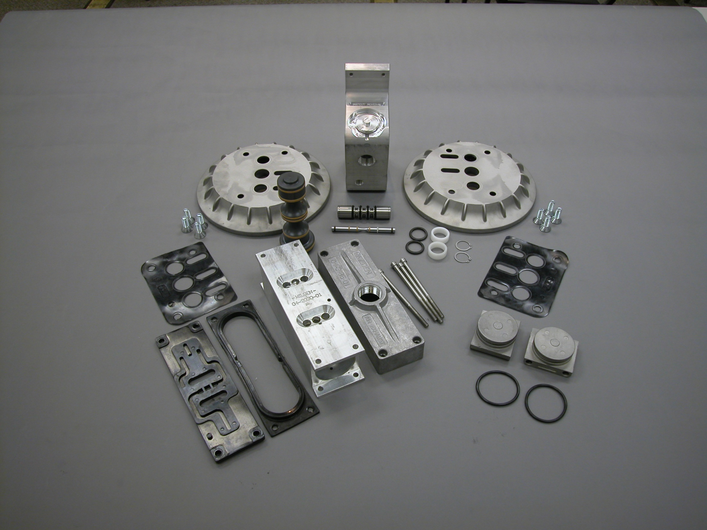
Wilden 1 1/2” Pro-Flo X ADS
34 parts

Slide 5
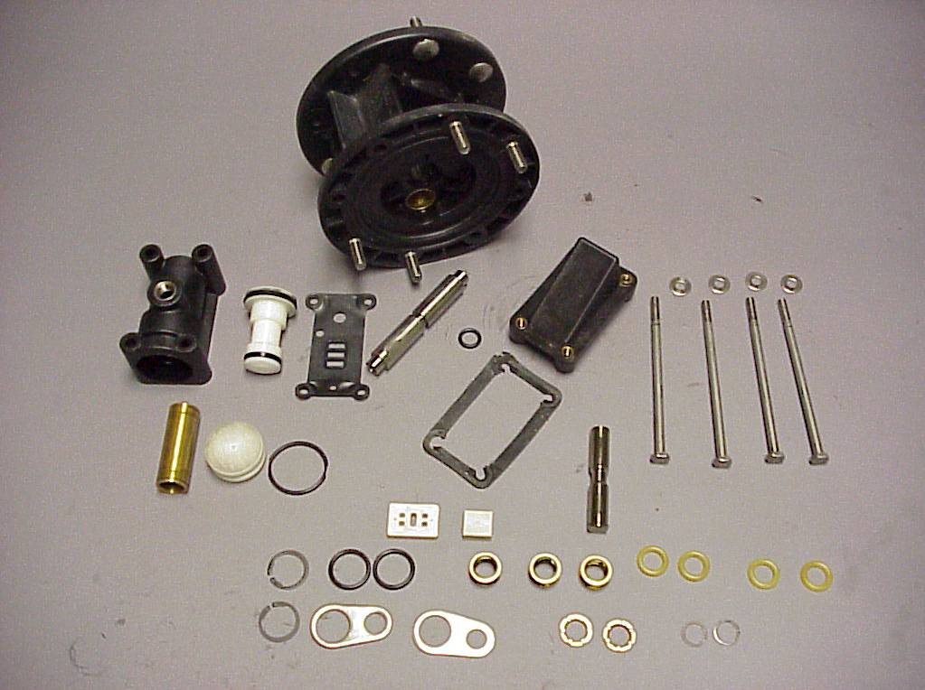
Aro 1/2 inch Air Distribution System
48 Parts

Slide 6
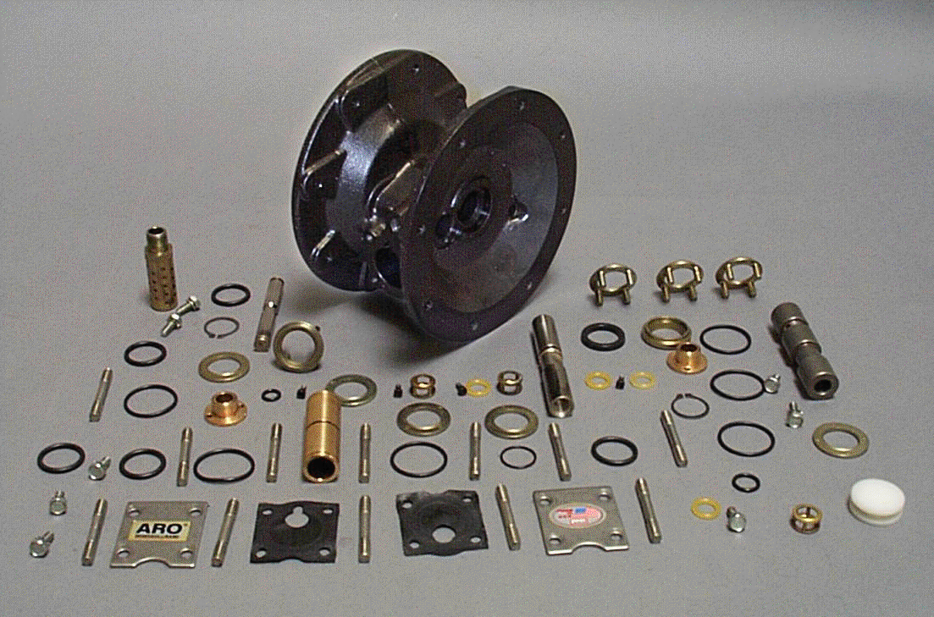
ARO 1” Air Distribution System Non-EXP
71 parts

Slide 7
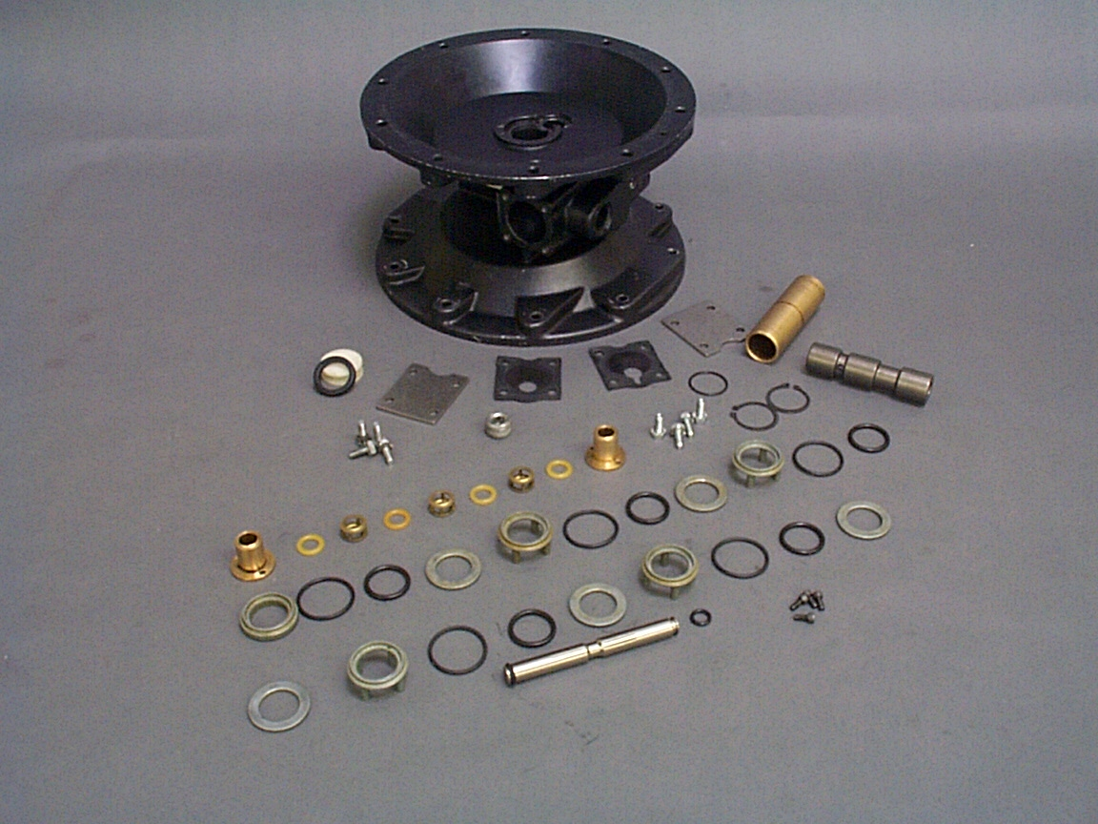
1-1/2” Aro Non-EXP Series
56 Parts

Slide 8
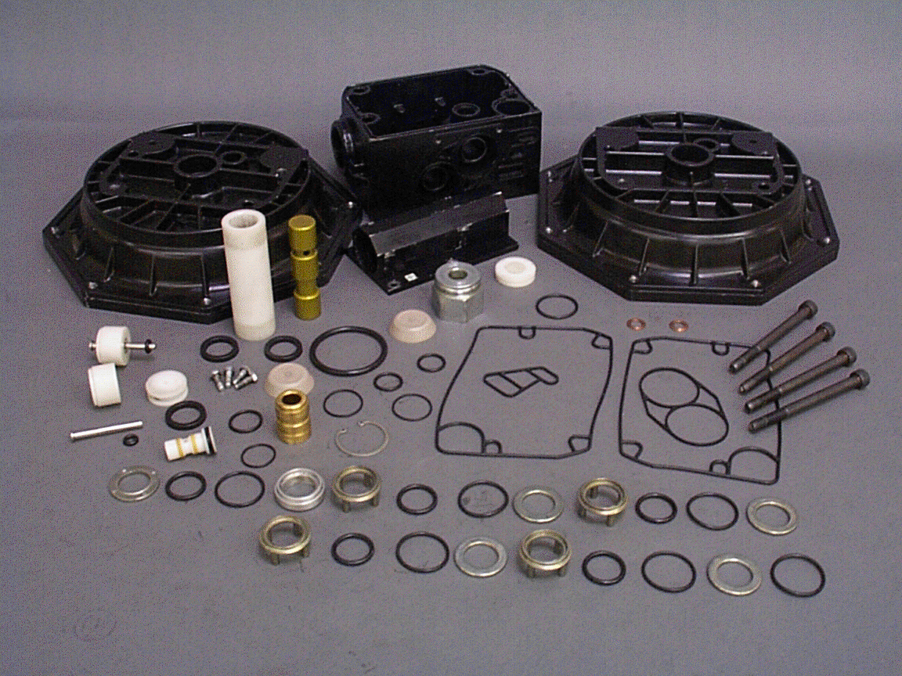
ARO 2” Air Distribution System Non-EXP Series
64 parts

Slide 9
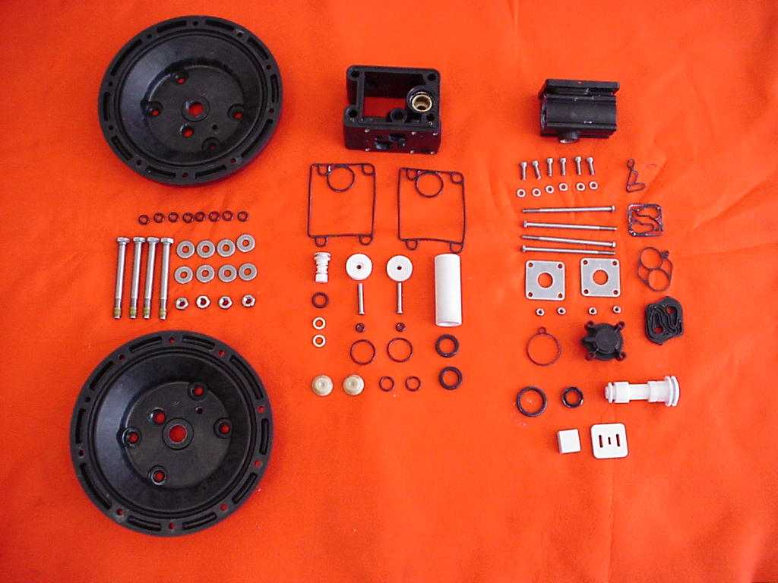
2-inch ARO EXP Series
FTI IMAGE
73 Parts

Slide 10
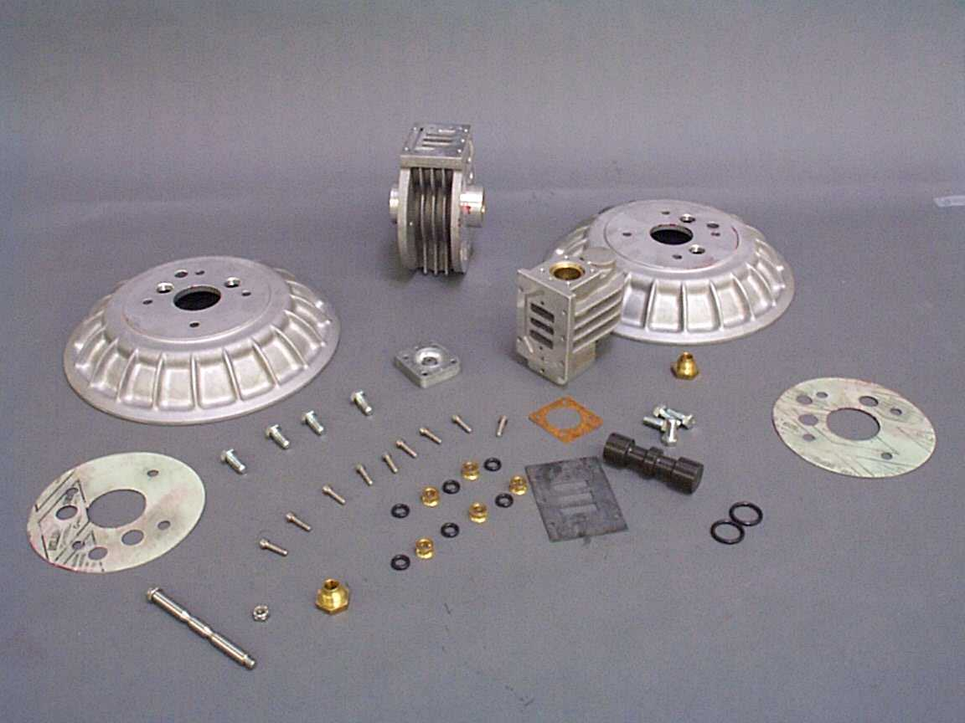
Versa Matic 2-inch Elimamatic
45 Parts

Slide 11
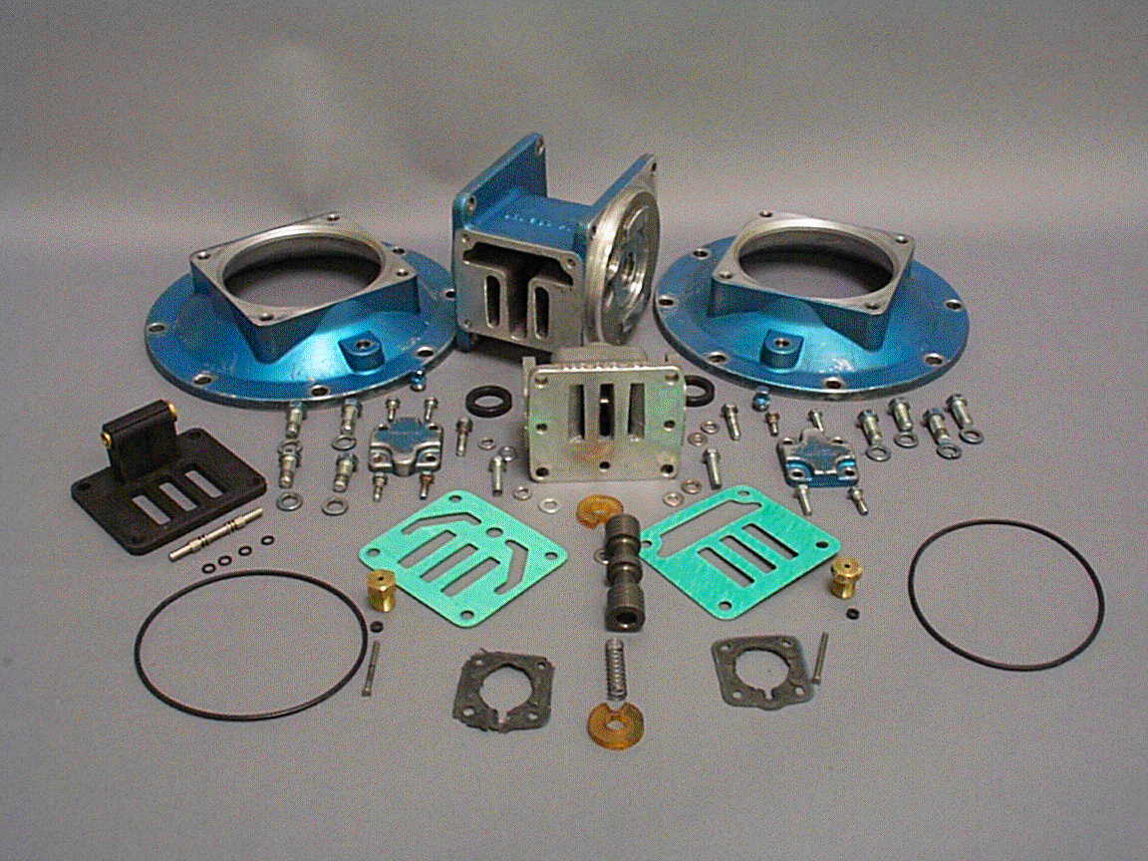
Warren Rupp 2” Air Distribution System
69 parts

Slide 12
ARO 1” Air Distribution System 666 Series
71 parts

Slide 13
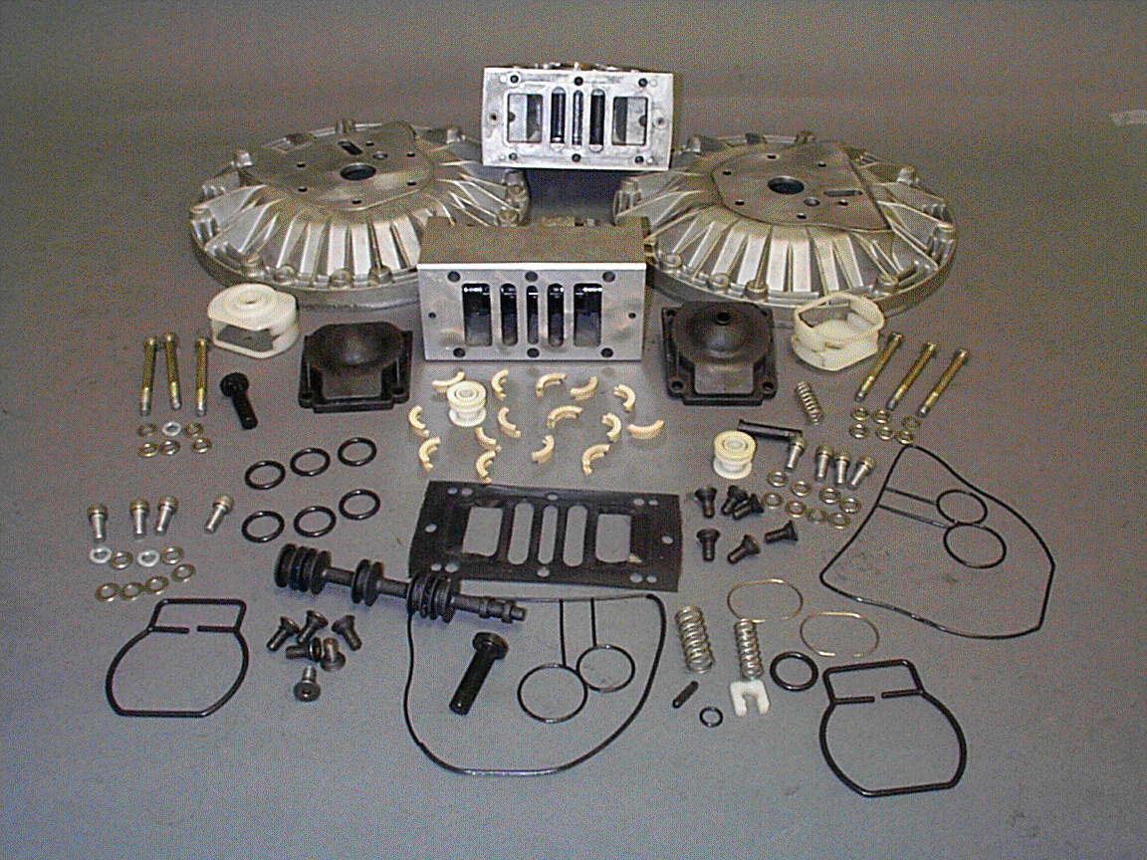
Yamada 2” Air Distribution System
103 parts

Slide 14
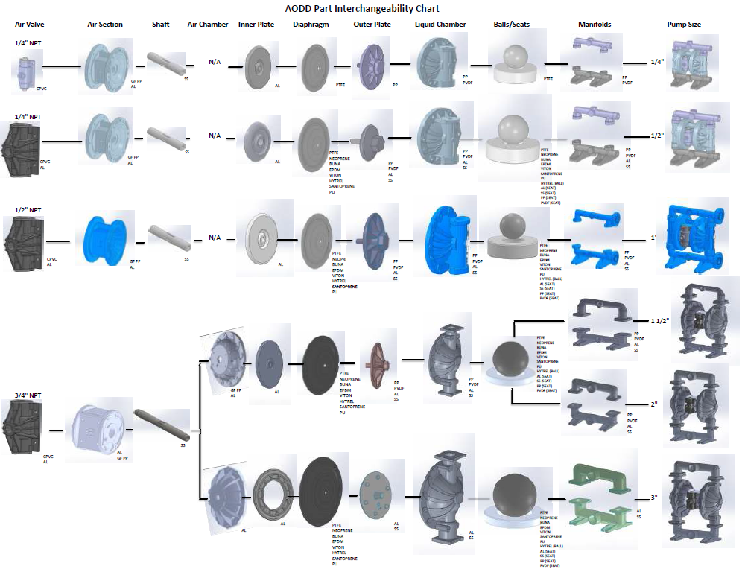

Slide 15
FTI AIR Nomenclature Plastic & Metal
FT
05
A
A
T
T
T
B
N
Pump Size
Wetted Parts
Non-Wetted Parts
Diaphragm
Valve Balls
Valve Seat
Connections
N: Neoprene
B: Buna-N
E: EPDM
H: Hytrel
R: Santoprene
F: FKM
U:Polyurethane
1: PTFE/Neo B.U.
2: PTFE/Sant B.U.
Valve Seat
O-Ring
N: Neoprene
B: Buna-N
E: EPDM
F: FKM
R: Santoprene
T: PTFE
025
05
10
15
20
30
A: Alum.
V: PVDF
P: Poly
S: SS
A: Alum.
P: Poly (GFPP)
A: Alum.
V: PVDF
P: Poly
S: SS
T: Teflon
B: BSP
F: ANSI / DIN ISO FLGE
N: NPT

Slide 16
Global Player In The AODDP Market

