Slide 1
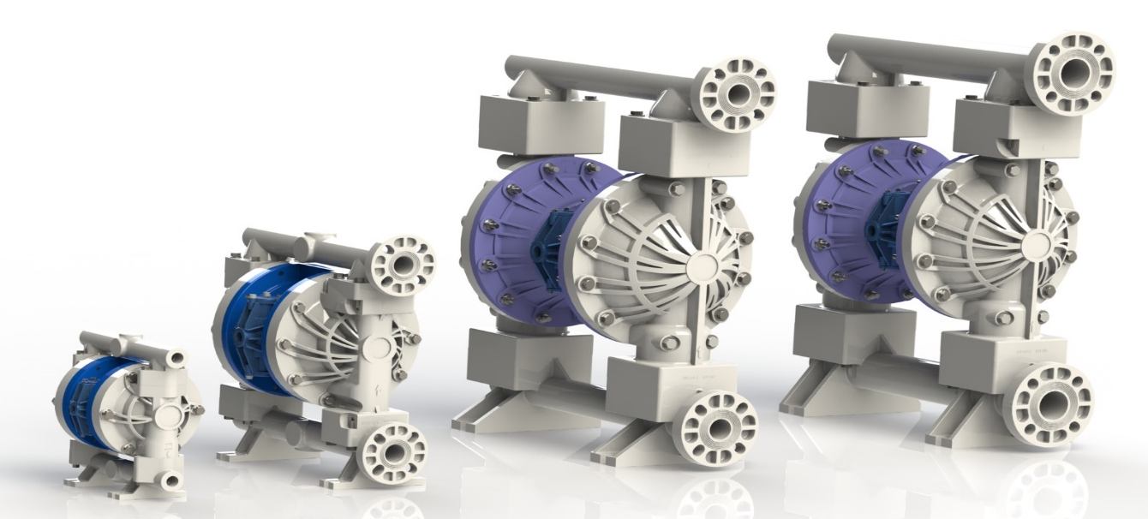
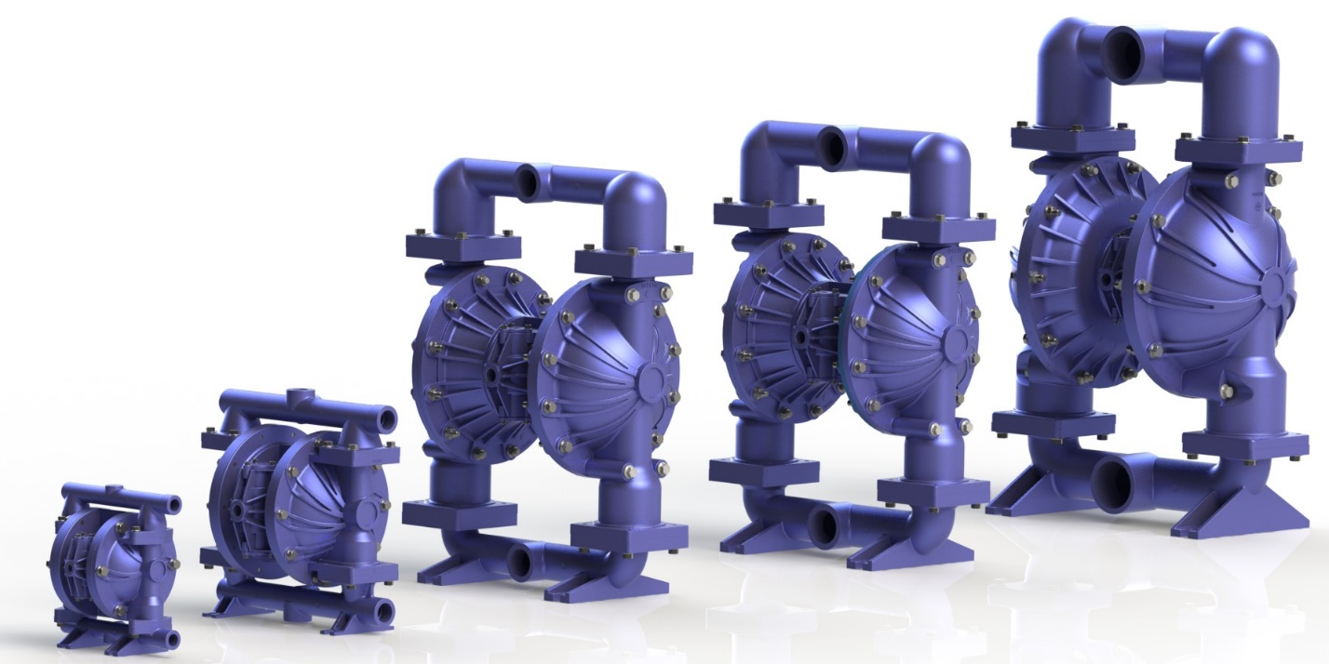
2016 Launch

Slide 2
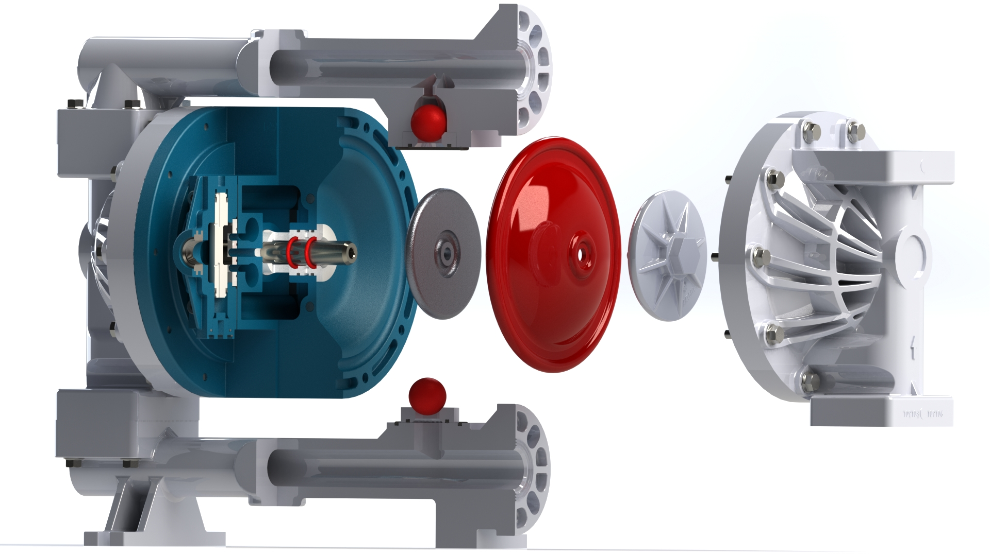
FTI Air Valve- How It Works

Slide 3
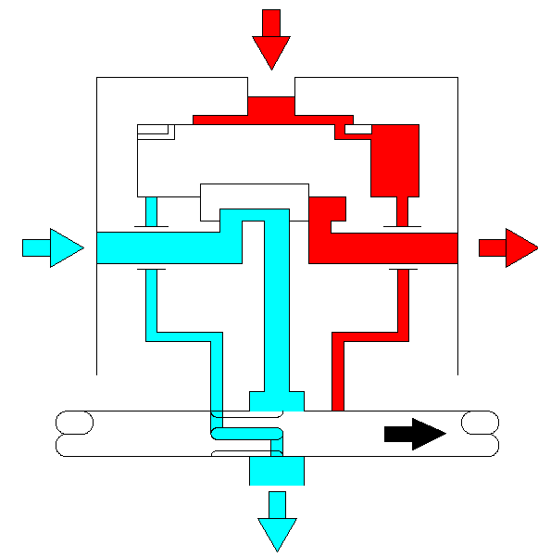
FTI Air Valve-How It Works
Right Hand Chamber Under Pressure

Slide 4
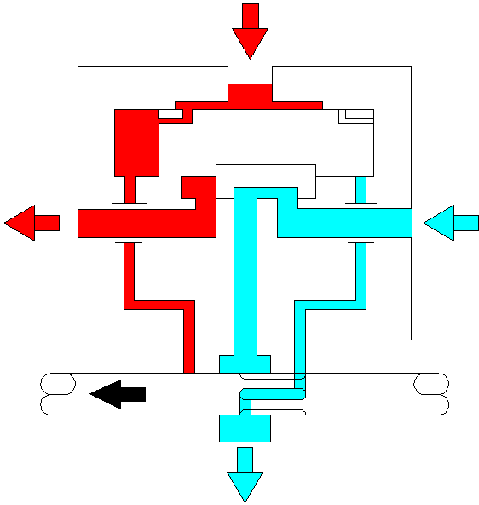
FTI Air Valve- How It Works
Left Hand Chamber Under Pressure

Slide 5
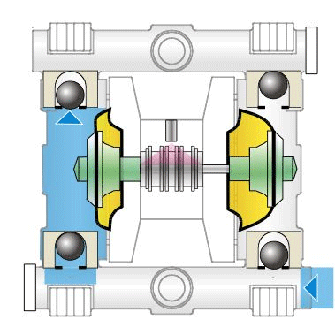
How It Works
Not FTI Air Pump Image Show Only

Slide 6
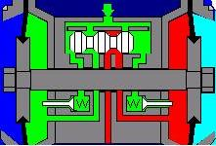
INLET AIR PRESSURE
The spool is kept
in his position
through equal
pressure on both
sides. ( A + B)
A
B
The left
diaphragm is
pressed outside
through air
pressure. As both
diaphragms are
connected to
each other with a
centre rod, the
other diaphragm
is pulled inside.

Slide 7
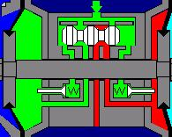
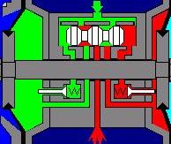
The shifting moment
The Centre Disk (1) makes contact with
the Pilot Valve (2) and presses it open.
The Pilot Valve (2) is normally closed by
a spring and air pressure.
1
2
Pilot Valve (2) is now open and
compressed air behind the spool (1) can
escape through the exhaust.
Because of this on side A the pressure is
increasing and the spool will start to
move.
A
1
2

Slide 8
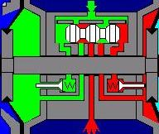
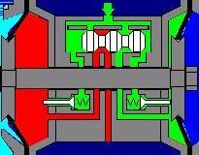
Pressure (1) can escape through
the exhaust. On the other side (2)
air pressure is still available.
Because of this the Spool can and will
move to the other side.
2
1
As the Spool is moving to the other
side, the exhaust channel (1) is
closing and now becomes the pressure
channel. (2) is now the exhaust channel.
The shifting moment is completed.
The Pilot Valve(3) is closed and the
centre rod, connected to the
diaphragms is now moving to the
upper direction.
2
1
3

Slide 9
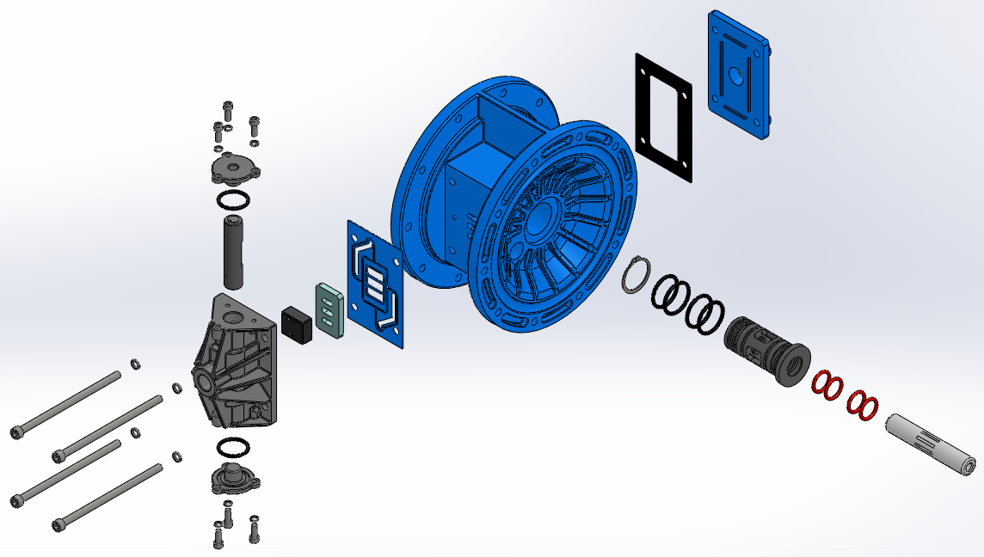
FTI AIR- Air Distribution System
Valve Carrier
Aluminum End Cap
Bushing
Slide Valve Shoe
Valve Plate

Slide 10
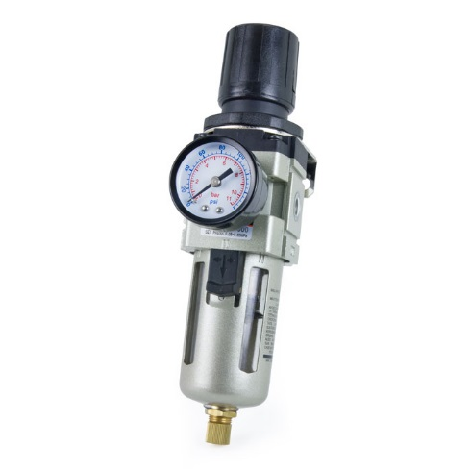
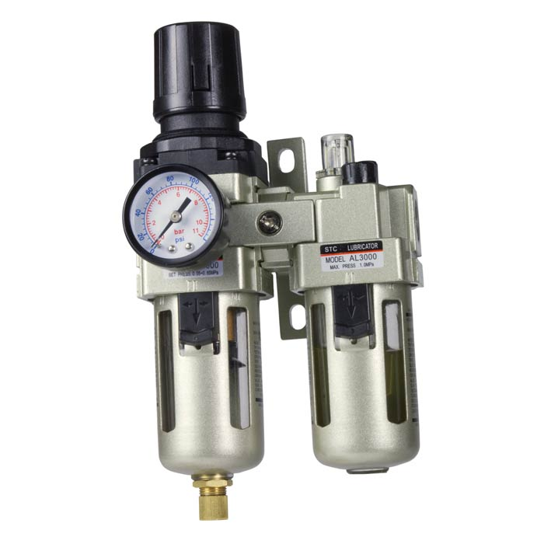
רצוי להשתמש תמיד במסנן/וסת אויר בכל התקנה!
זה יאריך משמעותית את חיי הדיאפרגמה והמשאבה!
זה ימנע חדירת לכלוך, לחות וחלקיקים למכלול האוויר

