Slide 1
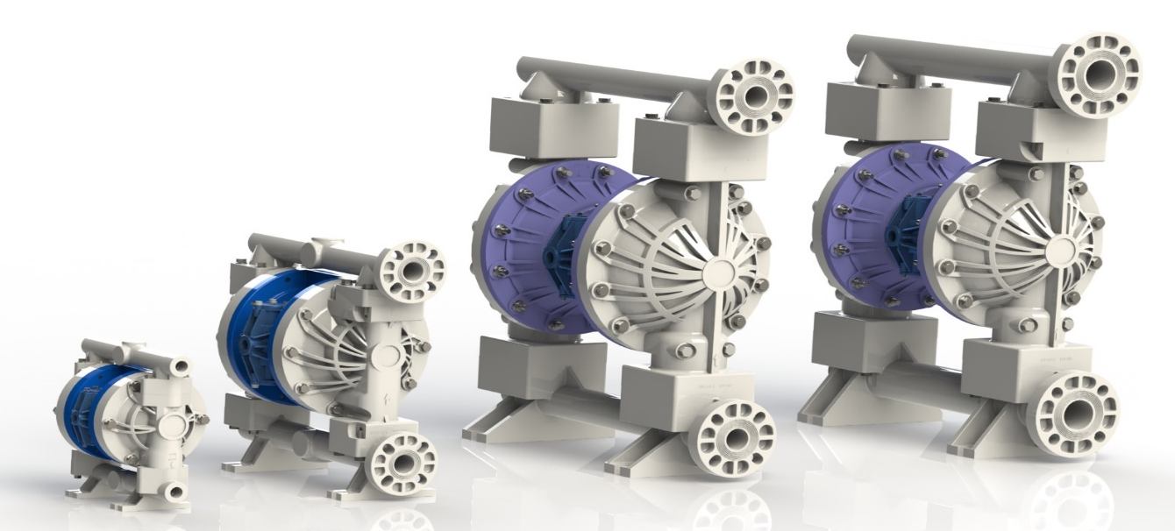
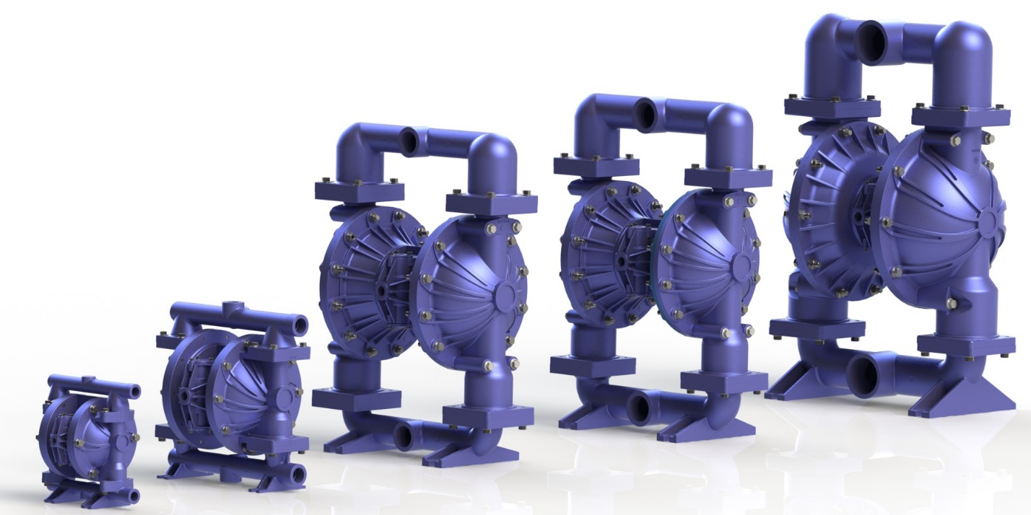
2016 Launch

Slide 2
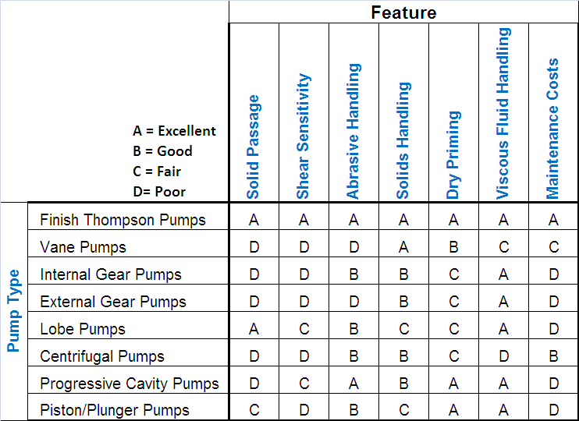
Why Choose a AODD Pump?
FTI has the infrastructure, knowledge base and intellectual capability to exceed customer expectations worldwide.

Slide 3
FTI AIR Metal Pumps

Slide 4
FTI AIR Product Range
Metal Range
05, 10, 15, 20, 30
Aluminum
316SS
Flow rate up to 240 USGPM (908 l/m)
120 PSIG (8.2 Bar)
Aluminum air valve & Aluminum
C-Section are standard.
GFPP air valve and C-Section are optional.
NPT, BSP or Flange Connections
CE and Atex certified

Slide 5
FTI AIR Plastic Pumps

Slide 6
FTI AIR Product Range
Plastic Range
025, 05, 10, 15, 20
Polypropylene
Temperature rating 0°C/32°F 70°C/158°F
PVDF (KYNAR)
Temperature rating -12°C/10.4°F 104.4°C/220°F
Flow rate up to 153 USGPM (580 l/m)
100 PSIG (6.8 Bar)
GFPP air valve & GFPP C-Section are standard.
NPT/BSP Tapped ANSI/DIN/ISO PN40 connections
CE Certified

Slide 7
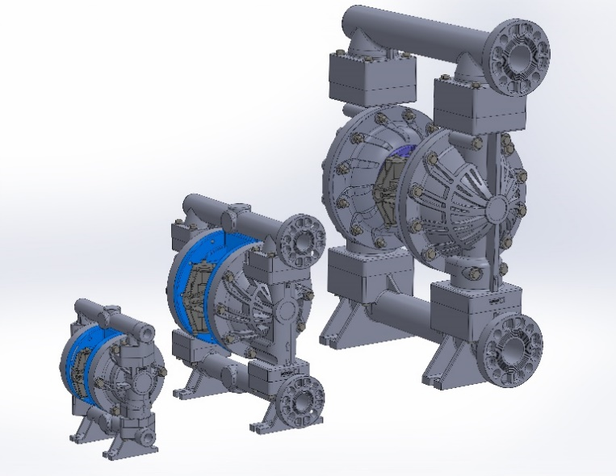
Features & Benefits
Bolted Construction Only
Provides leak-free safe fluid handling
Lube-Free
Pre-lubed at factory
Simplicity of Design
Commonality of parts
Lowest Number of Parts
Less parts than other competitors

Slide 8
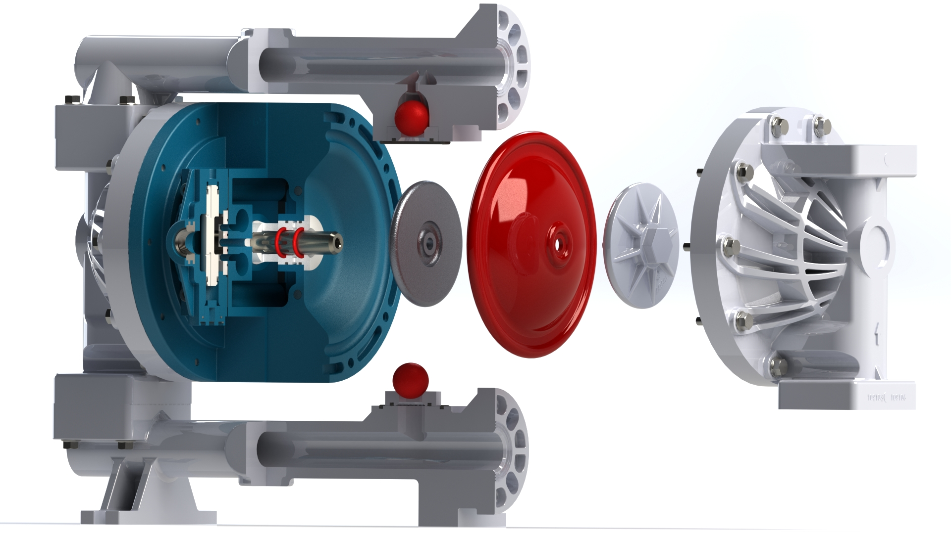
FTI AIR Elastomer Options

Slide 9
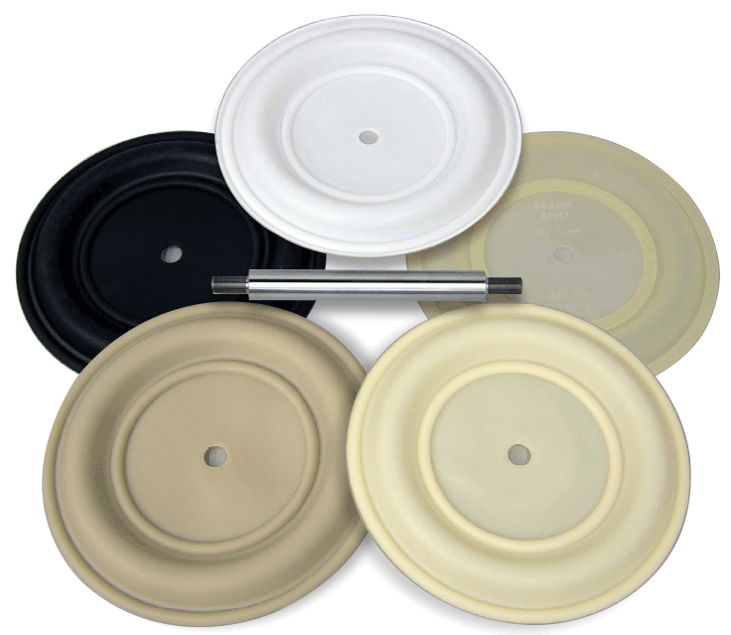
FTI AIR Elastomer Options
Full Flow – PTFE Diaphragm
Does not require any special configuration
Full Flow Diaph. uses same hardware as Rubber, TPE and PTFE
One Shaft for all elastomers

Slide 10
FTI AIR Advantages
Self priming, seal-less
Can be submerged
Run dry & deadhead capability
Excellent turndown (flow & pressure)
Can operate in classified areas
Good for shear sensitive products
Good for solids & abrasives
Simple to repair, inexpensive to purchase

Slide 11
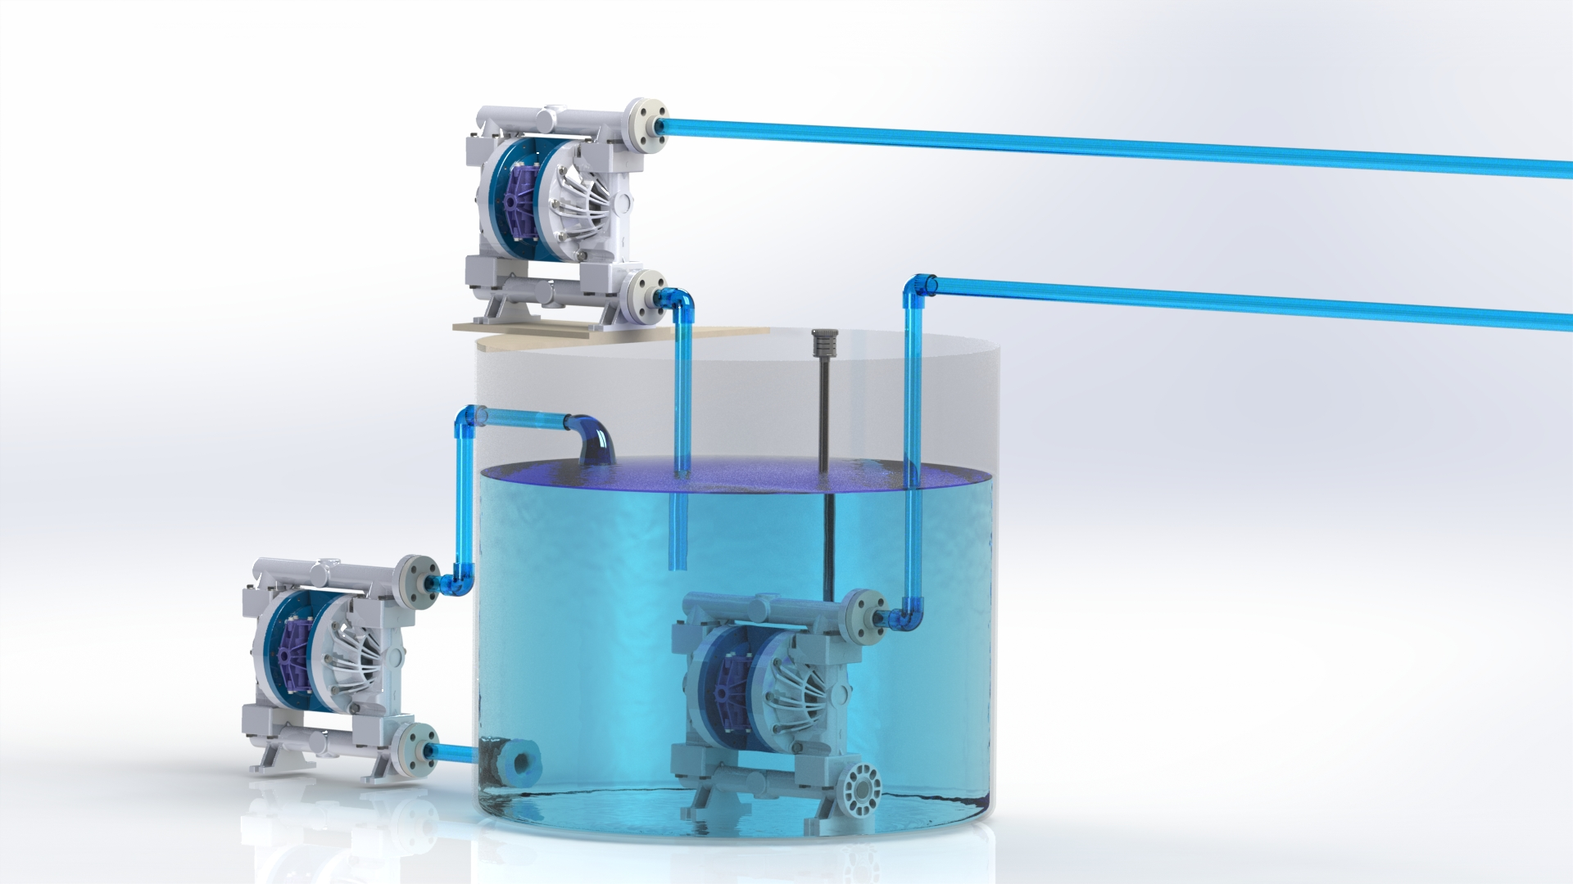
FTI AIR Advantages
Self-Priming
Flooded Suction
Submergible

Slide 12
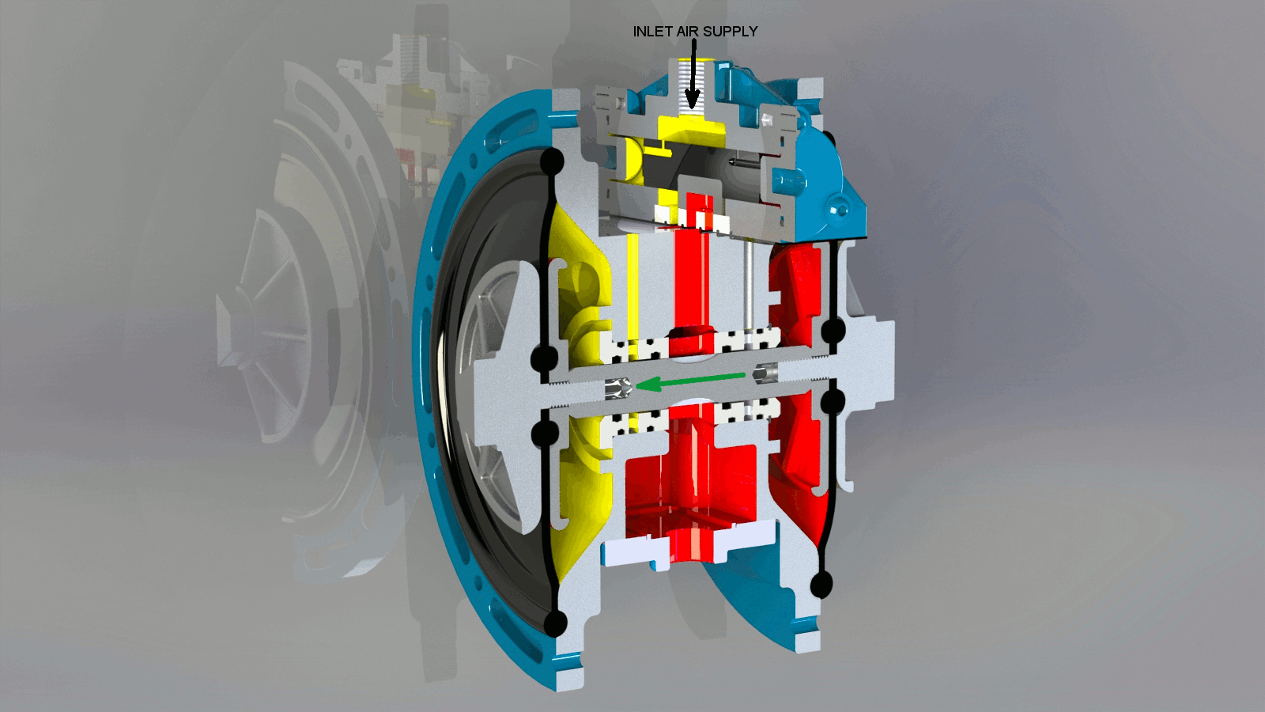

Slide 14
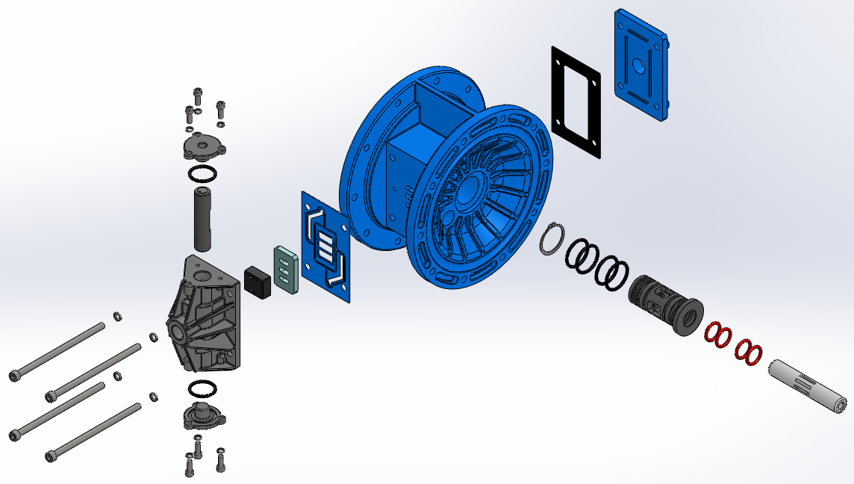
FTI AIR- Air Distribution System
Valve Carrier
Aluminum End Cap
Bushing
Slide Valve Shoe
Valve Plate

Slide 15
FTI AIR Center Section Assembly

Slide 16
FTI AIR – Valve Options
Metal Air Valve
Plastic Air Valve
Three Valves
½” Pump
1” Pump
1-½”, 2”, 3” Pumps
Valve Carrier: Anodized Aluminum
Valve Shoe: Carbon filled PTFE
Valve Plate: Ceramic
Four Valves
¼” Pump
½” Pump
1” Pump
1-½”, 2” Pumps
Valve Carrier: PE Polyethylene
Valve Shoe: Carbon filled PTFE
Valve Plate: Ceramic
Notes:
UHMW polyethylene valve carrier with replaceable, permanently lubricated seals for long wear life due to the addition of low friction modifiers.

Slide 17
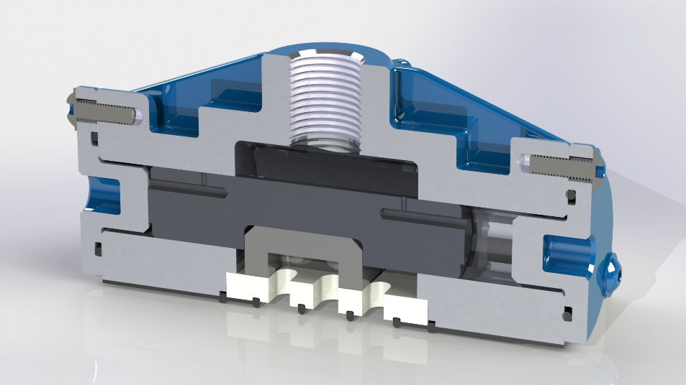
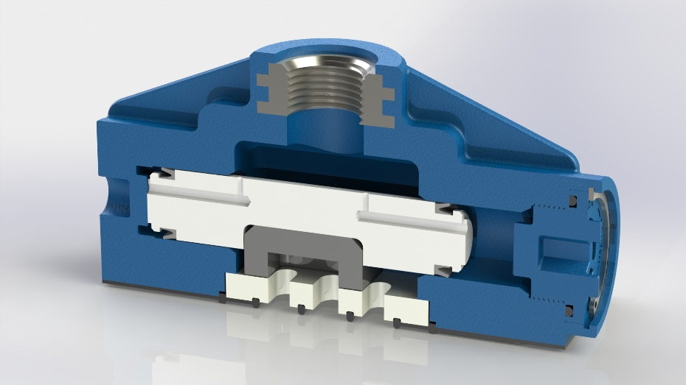
FTI AIR – Valve Materials
C-Section Shaft O-ring
Bushing O-ring
Bushings
Shaft
Plastic air valve
Metal air valve
TPE
Buna
Delrin (similar to acetal)
304 SS
GFPP
Aluminum
Notes:
The bushing is made of Delrin, which is a brand name for acetal.
The ID o-rings which we are calling the shaft o-rings are made of a self-lubricating polyurethane. The actual Parker material is Resilon P4311 but not sure that we would want to tell outside people that info, maybe that is just for our internal use.
The o-rings on the outside of the bushings are just buna but those are just there to seal air from getting around the outside of the bushing.
a

Slide 18
FTI AIR Pump Design
¼”, ½”, 1” pump designs will have a one piece molded glass fiber reinforced polypropylene or aluminum center section design complete with air chambers. ¼” will be plastic only
Single piece bushing is held in place by a snap ring
1 ½”, 2” pump designs will have glass fiber reinforced polypropylene or aluminum center section with separate air chambers
3” pump design will only have Aluminum C-section and air chambers
There are two bushings which are held in place by the air chambers

Slide 19
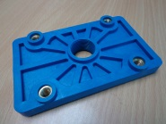
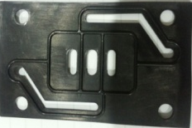
FTI Air Muffler Plate
Plastic or Metal Design
All air valve and muffler gaskets will be buna.
Glass fiber reinforced polypropylene (GFPP) muffler plate with stainless steel inserts

Slide 20
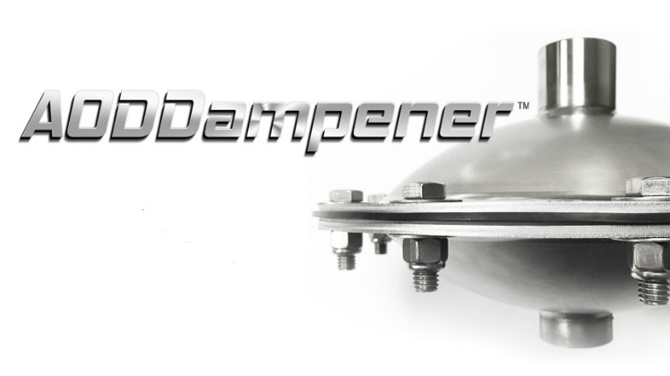
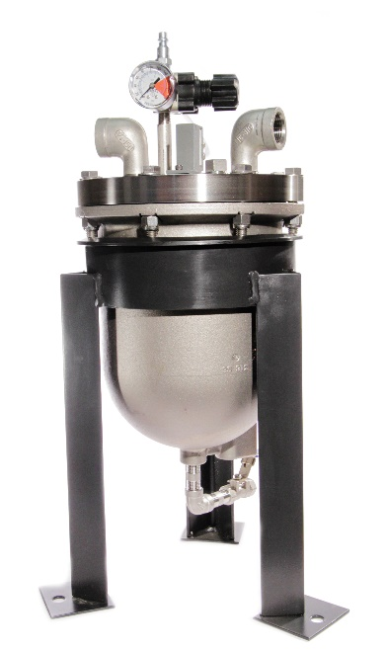
FTI Air Accessories
Spill Stopper
Metal and Plastic Pumps
Pulsation Dampeners
Metal and Plastic Pumps

Slide 21
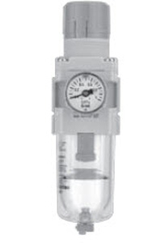
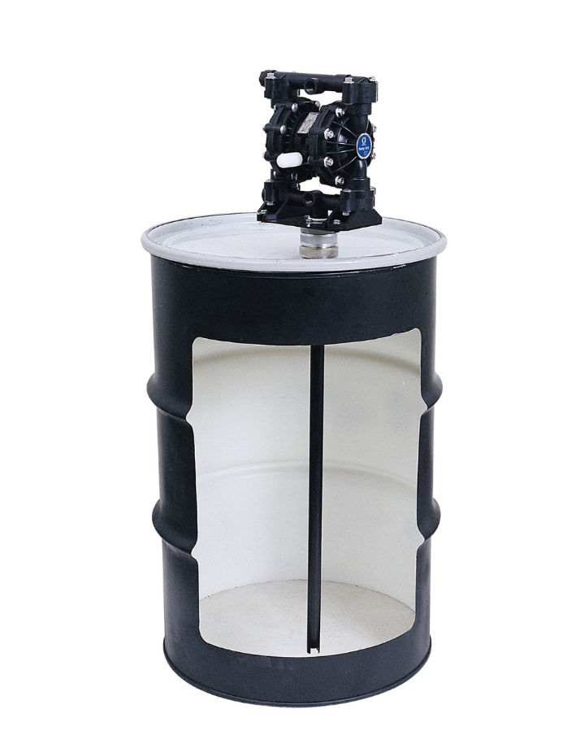
FTI Air Accessories
Filter-Regulator
Drum Kit
¼” and ½” Pumps

Slide 22
Global Player In The AODDP Market

